Slide 1
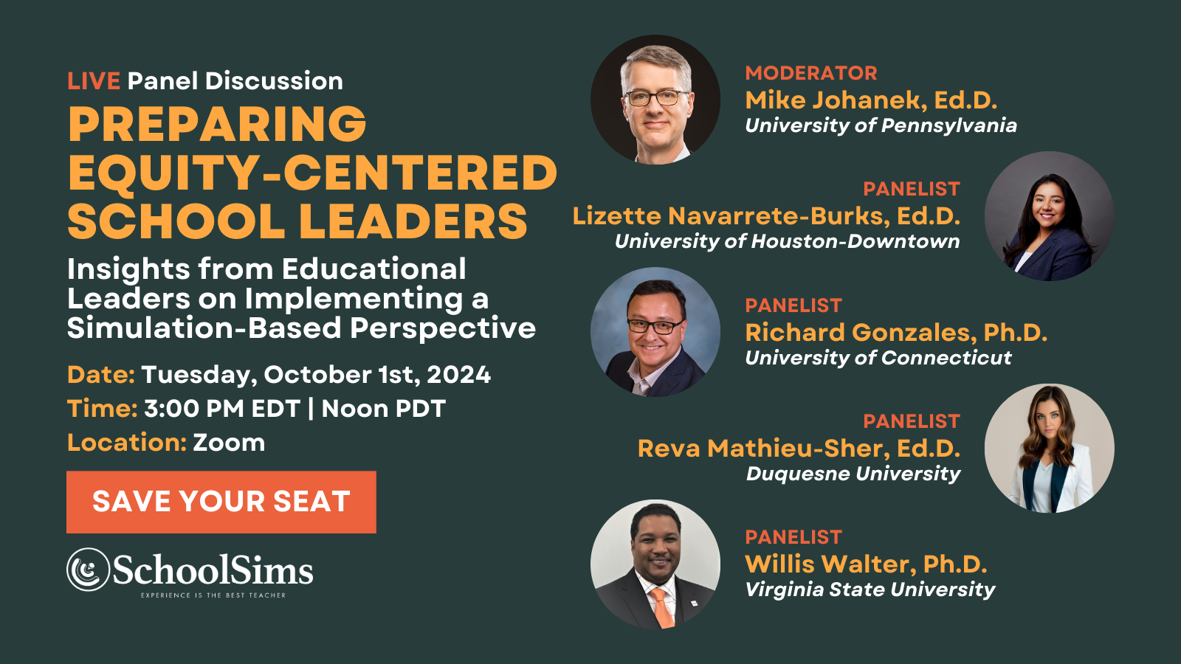

Slide 2
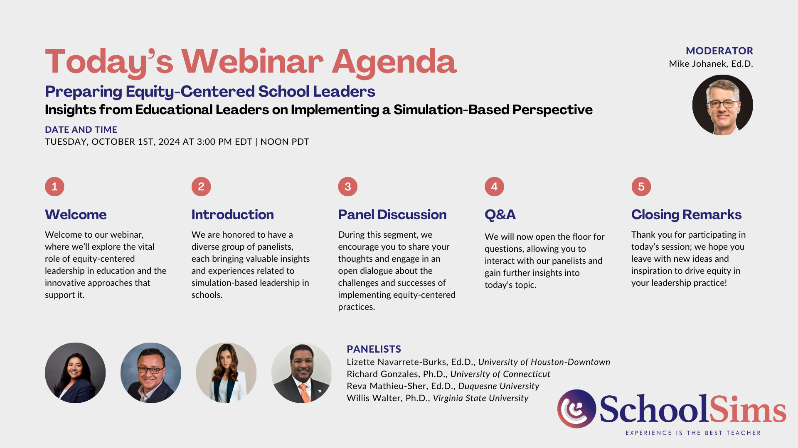

Slide 3
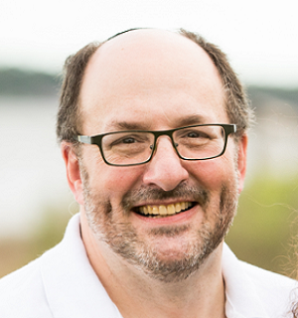

KEN SPERO
President & Co-Founder
kspero@schoolsims.com
Ken is an avid believer in the adage that Experience is the Best Teacher and, for over 30 years, has been utilizing computer-based simulations to allow professionals to safely learn from decision-making mistakes around some of the most challenging Problems of Practice. For the past six years, Ken has been focused on the challenge of the “Silent Crisis of Leadership in K-12,” working to enhance leadership capacity and improve critical thinking amongst school administrators.
Exclusive Resources
Simulation Overviews
Client Testimonials
Webinars
Explore detailed snapshots of each simulation, featuring key characters, discussion topics, relevant standards, and more!
Read success stories of schools that have implemented simulation-based learning with SchoolSims, highlighting their achievements and positive outcomes.
Access past webinars and discover valuable insights, resources, and expertise on various topics related to education and simulation-based learning.
Preview the SchoolSims Library
Blog
Discover a diverse array of simulations tailored to support professional development through engaging and interactive learning experiences across various topics.
The SchoolSims Blog serves as a dynamic platform for insightful articles, updates, and resources on education, simulation-based learning, and innovative teaching methodologies.

Slide 4
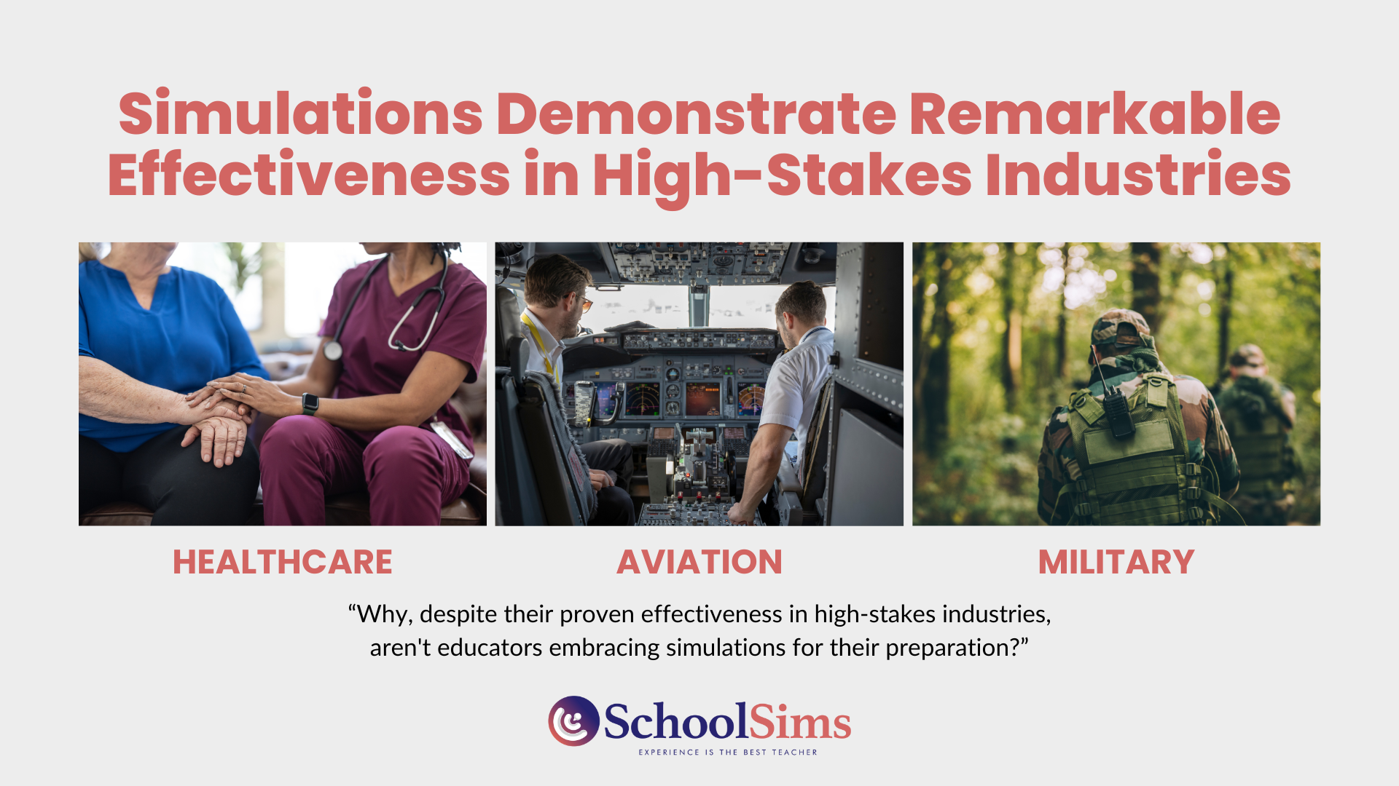

Slide 5


Slide 6
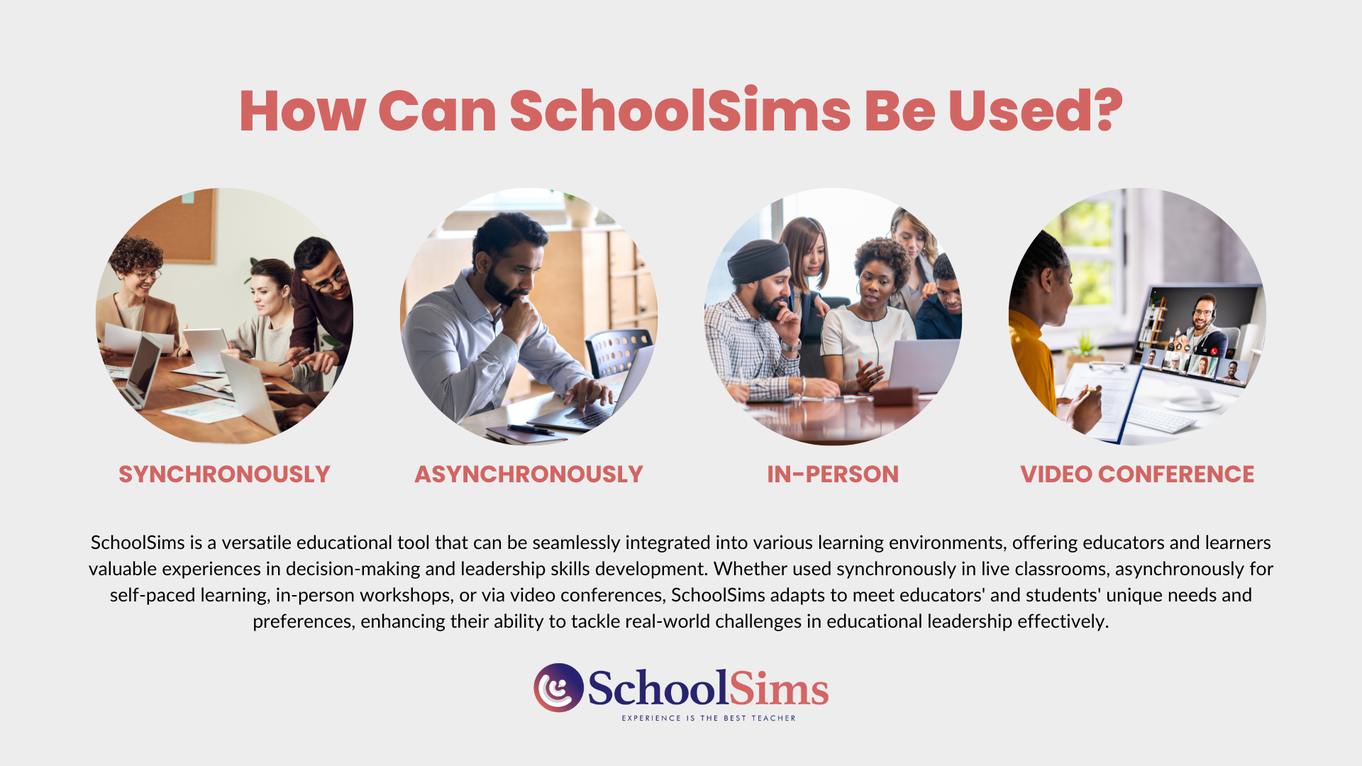

Slide 7
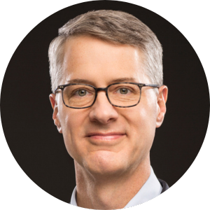

Michael Johanek, Ed.D.
Senior Fellow
University of Pennsylvania
How have you incorporated simulations into your program to enhance the development of equity-centered leaders? What unique benefits do simulations offer in the training of equity-centered leaders, particularly in relation to overcoming challenges in fostering equitable practices within schools?
We used simulations in several ways in the Mid-Career Doctoral Program in Educational Leadership when i served as Director. All applicants participated in simulations as part of their interview process, one of their first-year courses integrated simulations into the class, and several doc students are tapping simulations as data collection instruments in their dissertations.
In The Judgment Project, (thejudgmentproject.org ) we are looking at the use of simulations across fields - medicine, nursing, business, teaching, school leadership, policing - in developing the situated judgment professionals need for equity-centered practice.
In the Inter-American Educational Leadership Network (Red Interamericana de Liderazgo Educacional, RILE; www.rilecolaboracion.org ), we are deploying a common simulation across four countries to explore urban elementary school leadership practices, including explicit novice-expert comparisons and the relationship of sim performance to variables like leader self-efficacy..

Slide 8

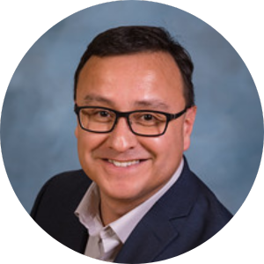
Dr. Richard Gonzales
Associate Professor in Residence
Director of Educational Leadership Preparation Programs
University of Connecticut, Neag School of Education
Richard Gonzales is an associate professor in residence and director of educational leadership preparation programs at the Neag School of Education. He served as project director for UConn’s University Principal Preparation Initiative project which was funded by the Wallace Foundation and currently facilitates the Texas Program Improvement Network initiative to support leader preparation programs engaged in continuous improvement.
Dr. Gonzales received a B.S. in applied learning and development and a M.Ed. and Ph.D. in educational administration from The University of Texas at Austin. Before entering higher education, he worked for sixteen years as an elementary bilingual teacher, an elementary principal, and a district-level administrator.
UCAPP Equity Commitment:
The UConn Administrator Preparation Program (UCAPP) is committed to developing and preparing transformational school leaders with the competence and disposition to effect school policies and practices that realize equitable achievement, participation, service, and support outcomes for every student.

Slide 9
Dr. Richard Gonzales
Associate Professor in Residence
Director of Educational Leadership Preparation Programs
University of Connecticut, Neag School of Education
How do simulations matter to the development of equity-centered leaders?
Simulations provide aspiring leaders the opportunity to think about and make decisions through sheltered practice. Conversations with peers, leadership coaches, and instructors prompt individuals to think ahead about and reflect on the implications of their decisions and whether those actions align with their core values and external expectations such as those we define for UCAPP leaders.
What unique benefits do simulations offer in the training of equity-centered leaders, particularly in relation to overcoming challenges in fostering equitable practices within schools?
The SchoolSims scenarios are realistic in that they present a situation with incomplete information, less-than-ideal options, and no “right answer”. That’s reality of leadership. Aspiring leaders come to accept this as the reality in which they must take action, compromise often, and realize outcomes that are as fair and just as possible, even if incrementally.
Even though there is no “BACK” button in real life or in SchoolSims, the online structure allows for repeating the entire experience and choosing different options in subsequent iterations. And, as mentioned above, listening to and talking with others promotes leadership learning.

Slide 10
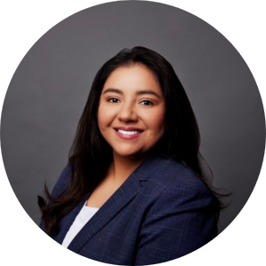

Dr. Lizette Navarrete-Burks
Assistant Professor of Educational Leadership
Fellow, UHD Center for Critical Race Studies
University of Houston-Downtown
Dr. Lizette Navarrete-Burks is an Assistant Professor of Educational Leadership at the University of Houston-Downtown. She is a founding faculty member for a newly launched graduate degree program for aspiring PK12 school leaders. She brings years of experience as a core content classroom teacher and educational leader at the district, state, and national levels to her courses. Lizette’s research interests focus on STEM educational leadership, equitable PK20 policies and practices, and supporting school leaders to enact more socially just practices.
She recently served as Co-Chair for the National Board for Professional Teaching Standards (NBPTS) Diversity, Equity, & Inclusion Standards Committee. She was later invited back to serve as a member of their Global Diversity, Equity, & Inclusion Policy Revision Committee to continue expanding the groundwork.
Educational Leadership Graduate Degree Program at UHD:
–Specifically designed to prepare K-12 educational leaders to lead in culturally and linguistically diverse schools.
–Develop transformational leaders in education with a passion for quality and equity.
–Supports aspiring school leaders in translating visionary ideas into equitable school improvement.

Slide 11
Dr. Lizette Burks
Assistant Professor of Educational Leadership
University of Houston-Downtown
How have you incorporated simulations into your program to enhance the development of equity-centered leaders?
I utilize a multimedia tool in our online LMS that enables voice conversations to unpack simulations incorporated into courses. Students enjoy how this tool allows for sharing through asynchronous voice messaging throughout the week to share insights. The simulations we utilize are robust, and using the multimedia tool to unpack them has given us a way to discuss the multiple dimensions of equity often incorporated into each.
What unique benefits do simulations offer in the training of equity-centered leaders, particularly in relation to overcoming challenges in fostering equitable practices within schools?
Utilizing the multimedia voice messaging tool and simulations combined has provided me with a way to incorporate culturally responsive pedagogy into my courses. I predominantly work with aspiring Leaders of Color. Students relate to the simulation by including their experiences challenging oppression, promoting connectedness, and aspiring to lead equitably. The opportunity has allowed students to tell their stories as they make meaning together through the simulations.

Slide 12


Dr. Reva Mathieu-Sher
Assistant Professor, School of Education
Duquesne University
Dr. Mathieu-Sher is an Assistant Professor of Special Education in the Department of Educational Foundations & Leadership at Duquesne University. She also serves as the Program Director of the Applied Behavior Analysis Program. Dr. Mathieu-Sher completed her doctoral training at the University of New England, focusing on Educational Leadership. She also holds a Master of Education from the University of Maine, focusing on high-incidence disabilities, and a Bachelor of Arts Degree in Psychology.
Before transitioning into higher education, Dr. Mathieu-Sher formerly held positions as a school superintendent, principal, special education director, and special education teacher in K-12 schools. Dr. Mathieu-Sher is also a board certified behavior analyst (BCBA).
Her research encompasses multifaceted and multi disciplinary interests and collaborations in leadership, behavior, and special education. Her research unpacks ways school leaders can best support teachers and administrators working within long-term crisis settings and how to successfully lead and support special education students and their families in K-12 schools.. She also focuses on research related to compassionate and culturally-responsive ABA treatment practices.
Duquesne provides the opportunity for undergraduates to meet competencies to become dual certified in general and special education, master’s level opportunities in Applied Behavior Analysis and Special Education, as well as doctoral studies in educational leadership with opportunities for K-12 supervision and administration certification at master’s and doctoral levels. The school of education at Duquesne is committed to meet the needs of all learners in schools.

Slide 13
Dr. Reva Mathieu-Sher
Assistant Professor, School of Education
Duquesne University
How have you incorporated simulations into your program to enhance the development of equity-centered leaders?
Our administration and supervision courses embed the use of simulations to prepare our future leaders to practice making informed, thoughtful, and compassionate leadership decisions in real time. Our ABA program also embeds the use of simulations as part of behavioral skills training (BST) to systematically teach compassionate care skills to future BCBAs and special education teachers..
What unique benefits do simulations offer in the training of equity-centered leaders, particularly in relation to overcoming challenges in fostering equitable practices within schools?
Simulations offer students a unique opportunity to apply the theory and skills taught in class to real-life case study situations and scenarios. They also allow for divergent thinking, collaboration opportunities, and discussions as part of a multidisciplinary team. The opportunity to practice these essential skills allows students to hone their skills before applying them in future leadership roles when the stakes are much higher. Simulations can also provide essential opportunities for students develop and increase confidence in their skills.

Slide 14
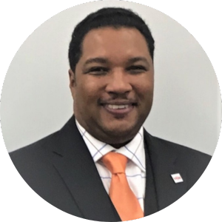

Dr. Willis Walter
Dean, College of Education
Virginia State University
Willis Walter is the Dean of the College of Education at Virginia State University. A medium size historically black college/university 25 miles south of Richmond Virginia. He is a tenured Associate Professor and a proud contributor to the programs that prepare Competent, Caring, and Culturally Responsive professionals in the areas of Teacher Education, Counseling Education, Health/Recreation/Sport Management, and Educational Leadership. Dr. Walter has over 20 years of higher education experience in leading academic programs, policies, and initiatives to promote teacher growth and student achievement.
Dr. Walter received his undergraduate and Master of Education Degrees from Florida Agricultural and Mechanical University and his Doctor of Philosophy and Educational Administration and Supervision P-12 certification from the University of Alabama at Birmingham. Before entering higher education, he worked as a K-12 teacher in Florida and Alabama, as well as a rural Middle School Assistant Principal and inner-city K-6 Elementary School Principal.
The Virginia State University College of Education mission is to promote quality programs, using current research and technology based learning to prepare effective reflective practitioners who are competent, caring and culturally responsive. When used appropriately, the Simulations are a major tool in our Educational Leadership Department carrying out the college of education’s mission.

Slide 15
Dr. Willis Walter
Dean, College of Education
Virginia State University
How do simulations matter to the development of equity-centered leaders?
Simulations provide aspiring leaders the opportunity for experiential learning. Faculty have the ability to immerse candidates in realistic scenarios, enabling them to make decisions and experience the consequences in a risk-free environment.
What unique benefits do simulations offer in the training of equity-centered leaders, particularly in relation to overcoming challenges in fostering equitable practices within schools?
Simulations provide a valuable opportunity to explore the dynamics of school culture and the effects of demographic changes on educational attainment. In today's diverse and rapidly evolving environment, this understanding is essential for effective leadership. Through simulations my faculty have been able to merge theory with practice, allowing candidates to better navigate the complexities of their future roles and their possible contributions in creating inclusive and equitable educational spaces.

Slide 16
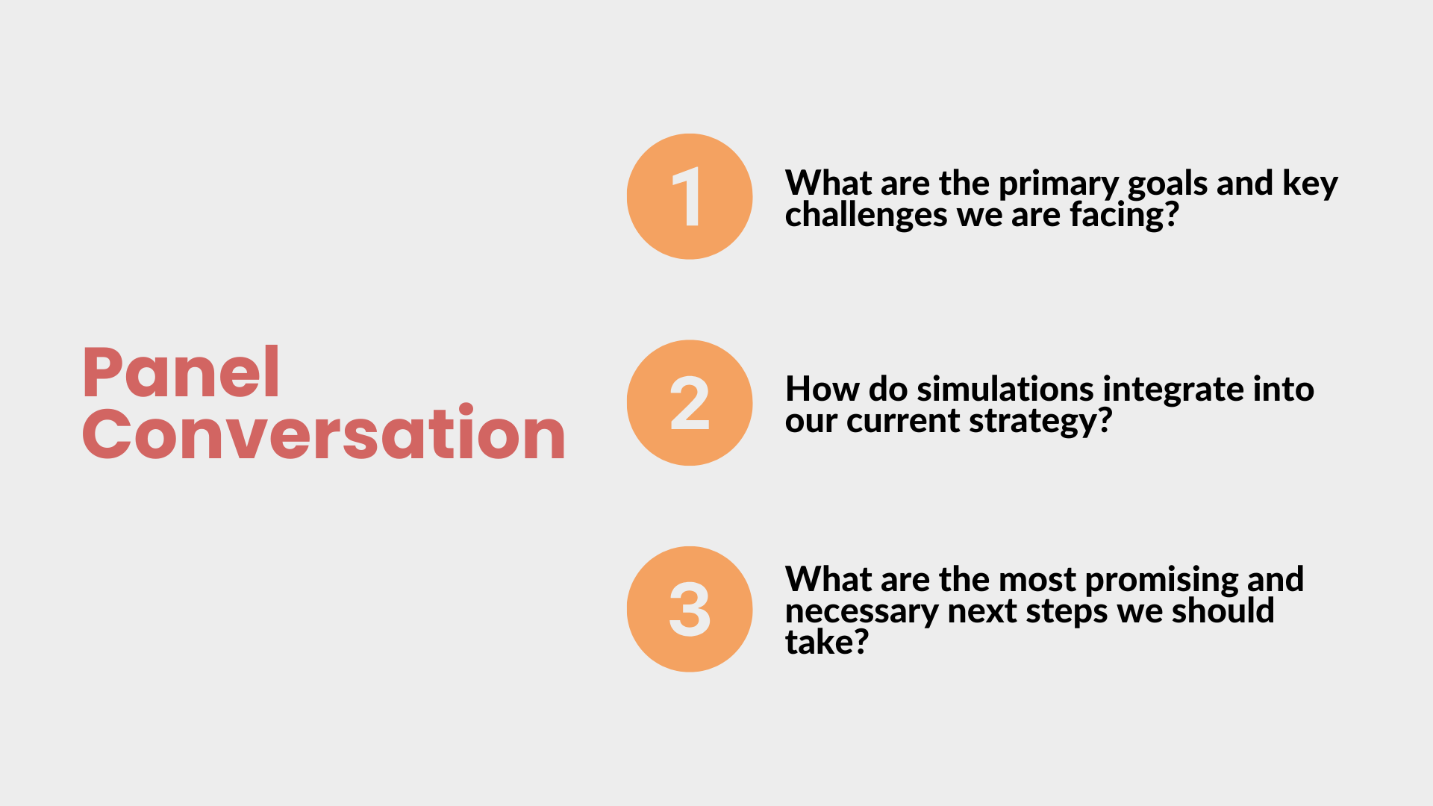
Notes:
A question of current practice as well as the end goal: How would you summarize, very briefly, what a well-prepared “equity centered leader” is? How do you know if you’ve succeeded in preparing one, in being one? What would you notice or observe? What are the most frequent and challenging issues faced by leaders in implementing equity-centered leadership on the ground?
In terms of preparation and support for equity-centered leaders: How do simulations fit into this? In what ways do they add to your toolkit in developing equity-centered leaders? What challenges have you found? In what ways do sims relate to the rest of your preparation programs?
Where do we go next: As you continue to develop this work, what is most exciting? What is most urgent and important in this work?

Slide 17
Q&A

Slide 18
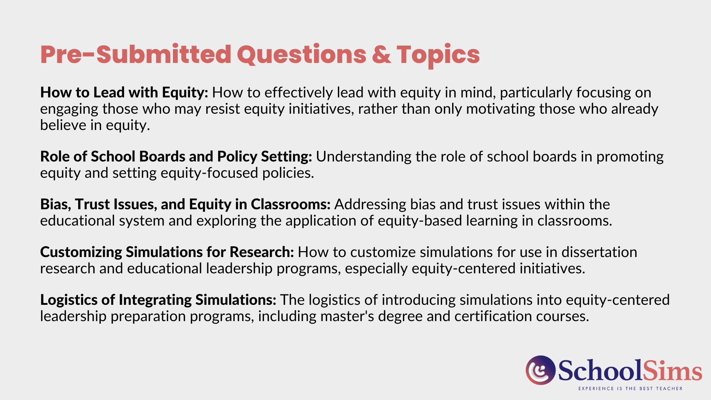

Slide 19


Slide 20
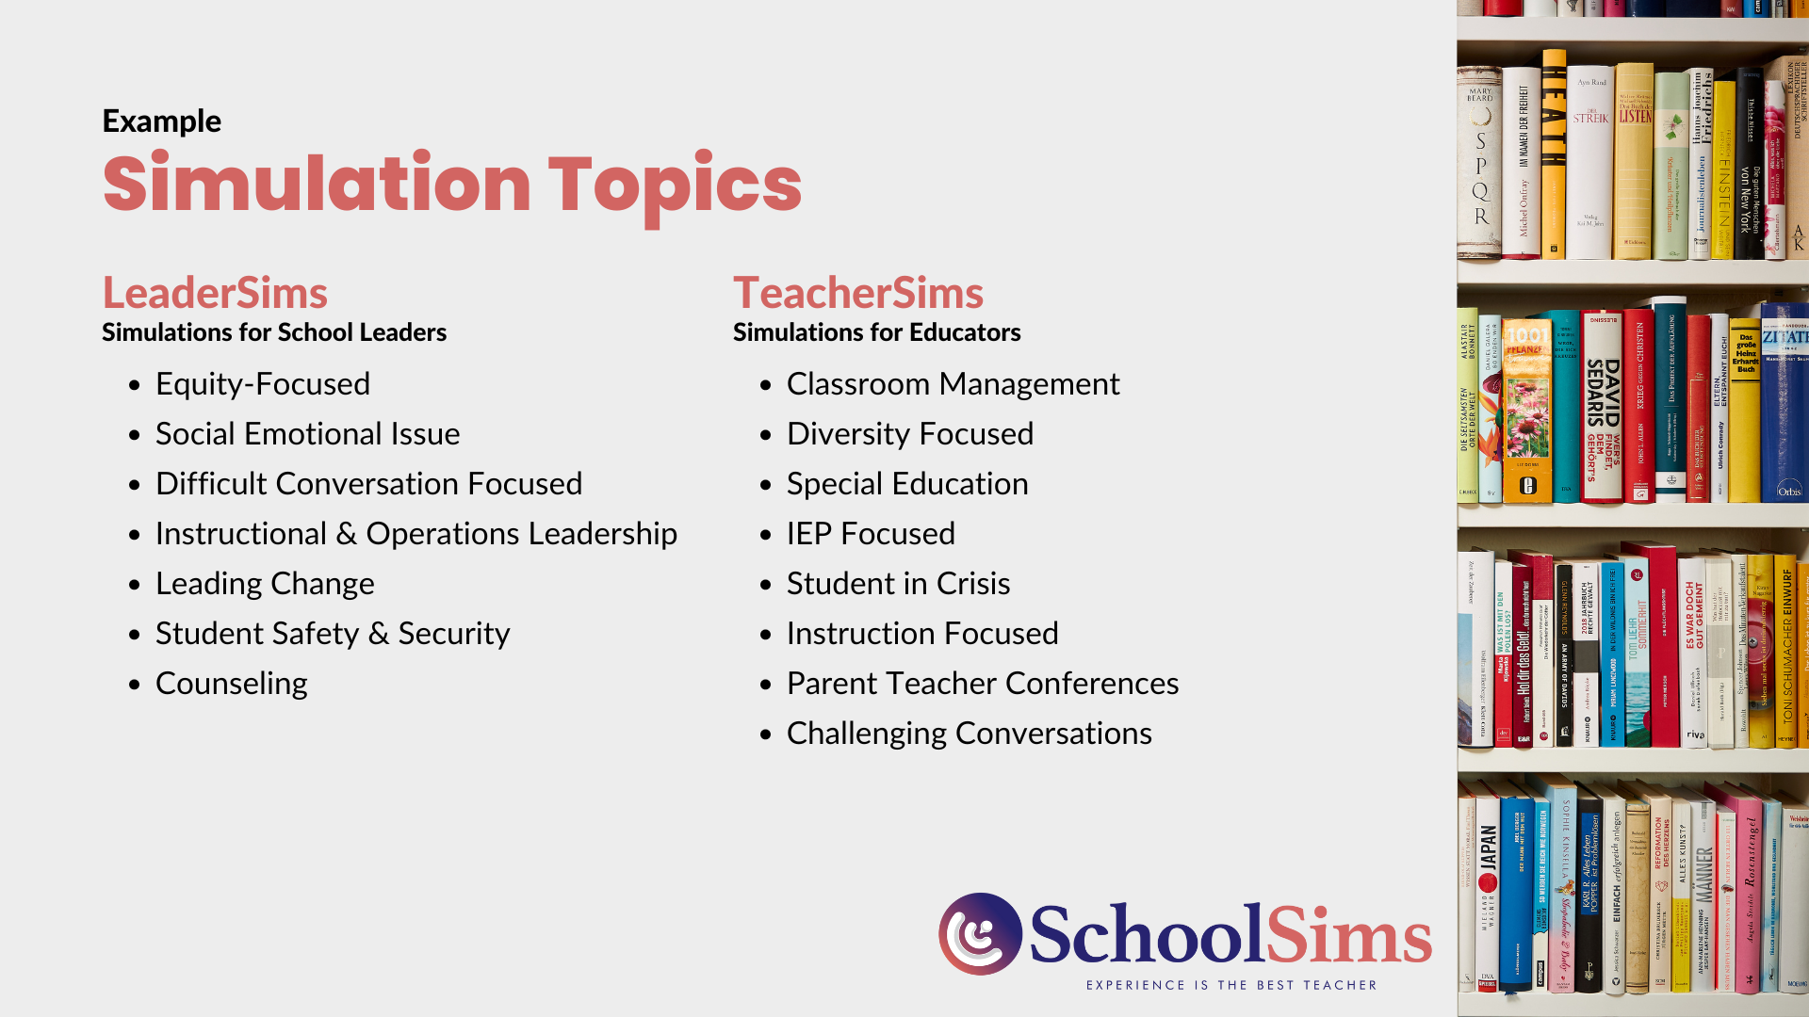

Slide 21
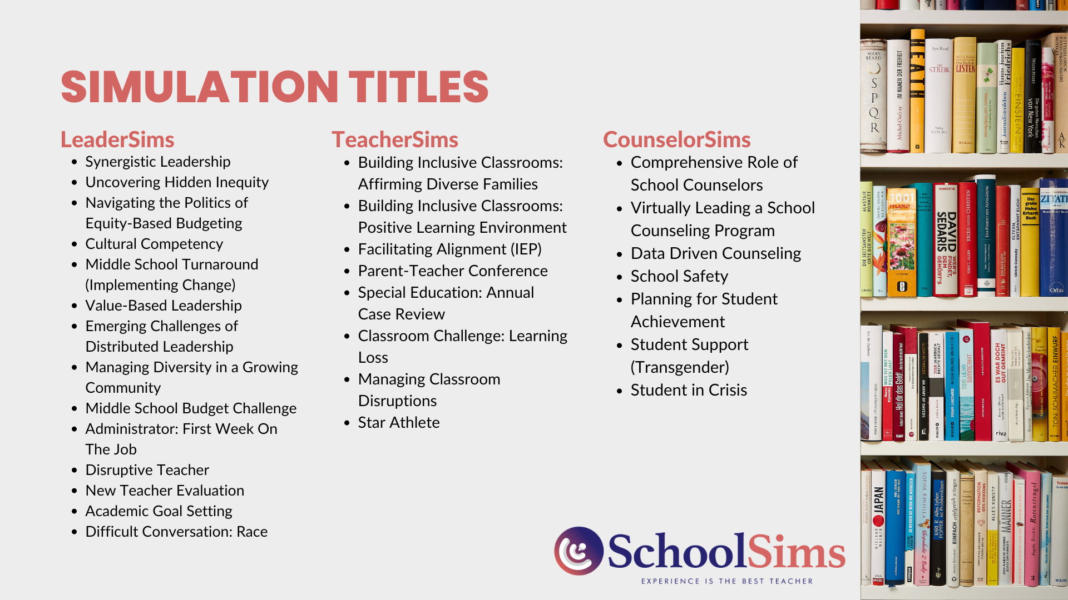

Slide 22


