Slide 1


Slide 2



BRENT COULSON
Client Experience Analyst
bcoulson@schoolsims.com
With a passion for education and a keen eye for detail, Brent collaborates closely with clients to understand their needs, providing tailored support and innovative solutions. His commitment to excellence and proactive problem-solving skills ensure top-tier service and valuable outcomes for educators and administrators. Brent's background in customer service and education technology helps bridge the gap between client expectations and product delivery, fostering strong, lasting relationships.
KEN SPERO
President & Co-Founder
kspero@schoolsims.com
Ken is an avid believer in the adage that Experience is the Best Teacher and, for over 30 years, has been utilizing computer-based simulations to allow professionals to safely learn from decision-making mistakes around some of the most challenging Problems of Practice. For the past six years, Ken has been focused on the challenge of the “Silent Crisis of Leadership in K-12,” working to enhance leadership capacity and improve critical thinking amongst school administrators.

Slide 3
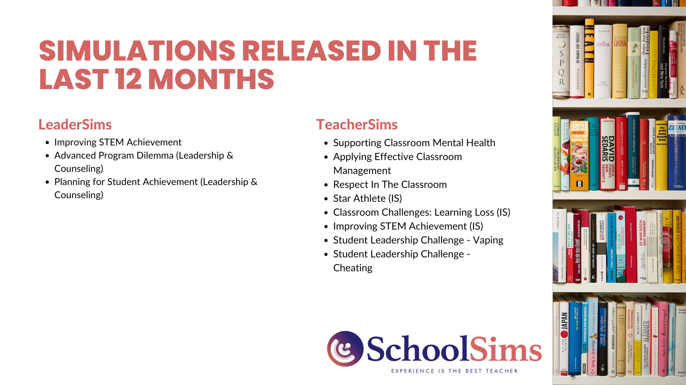

Slide 4
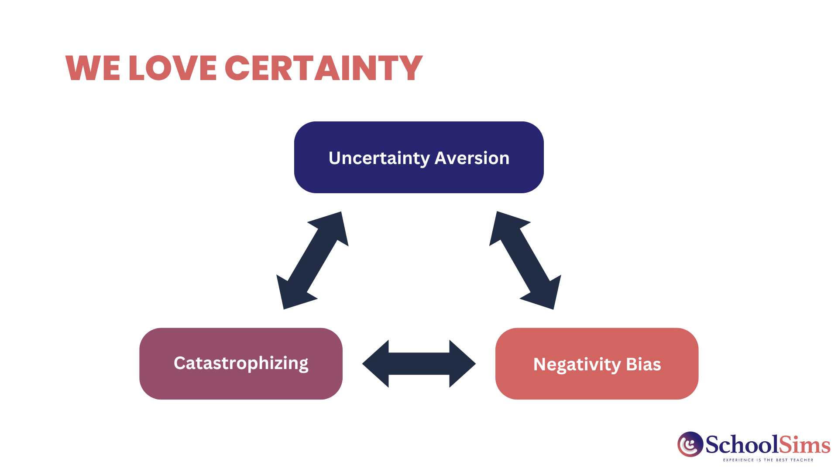

Slide 5
SIMULATION DATA

Slide 6
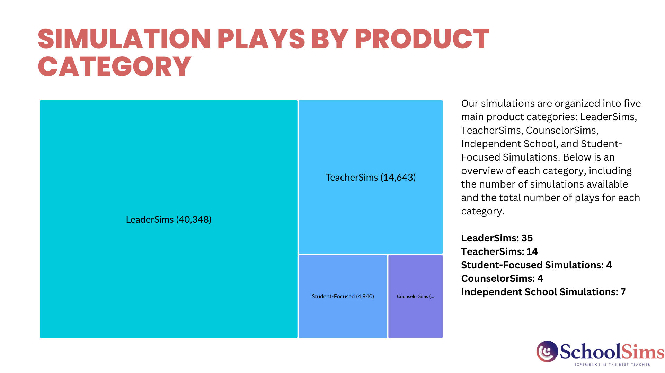

Slide 7
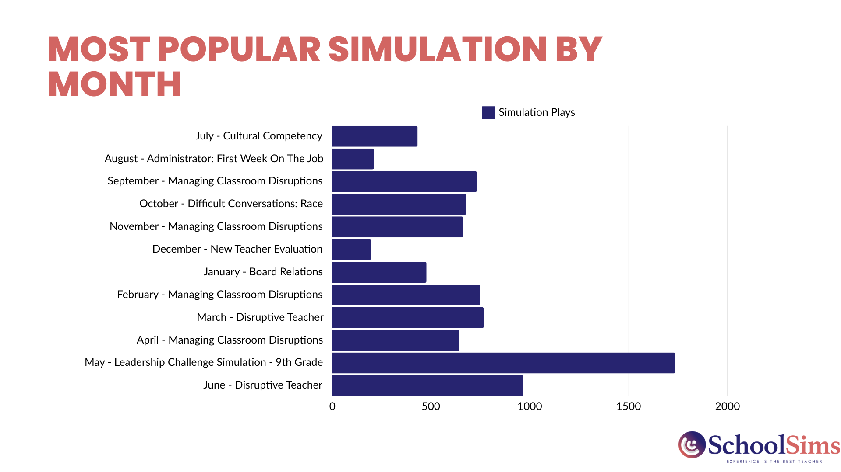

Slide 8
Q&A

Slide 9
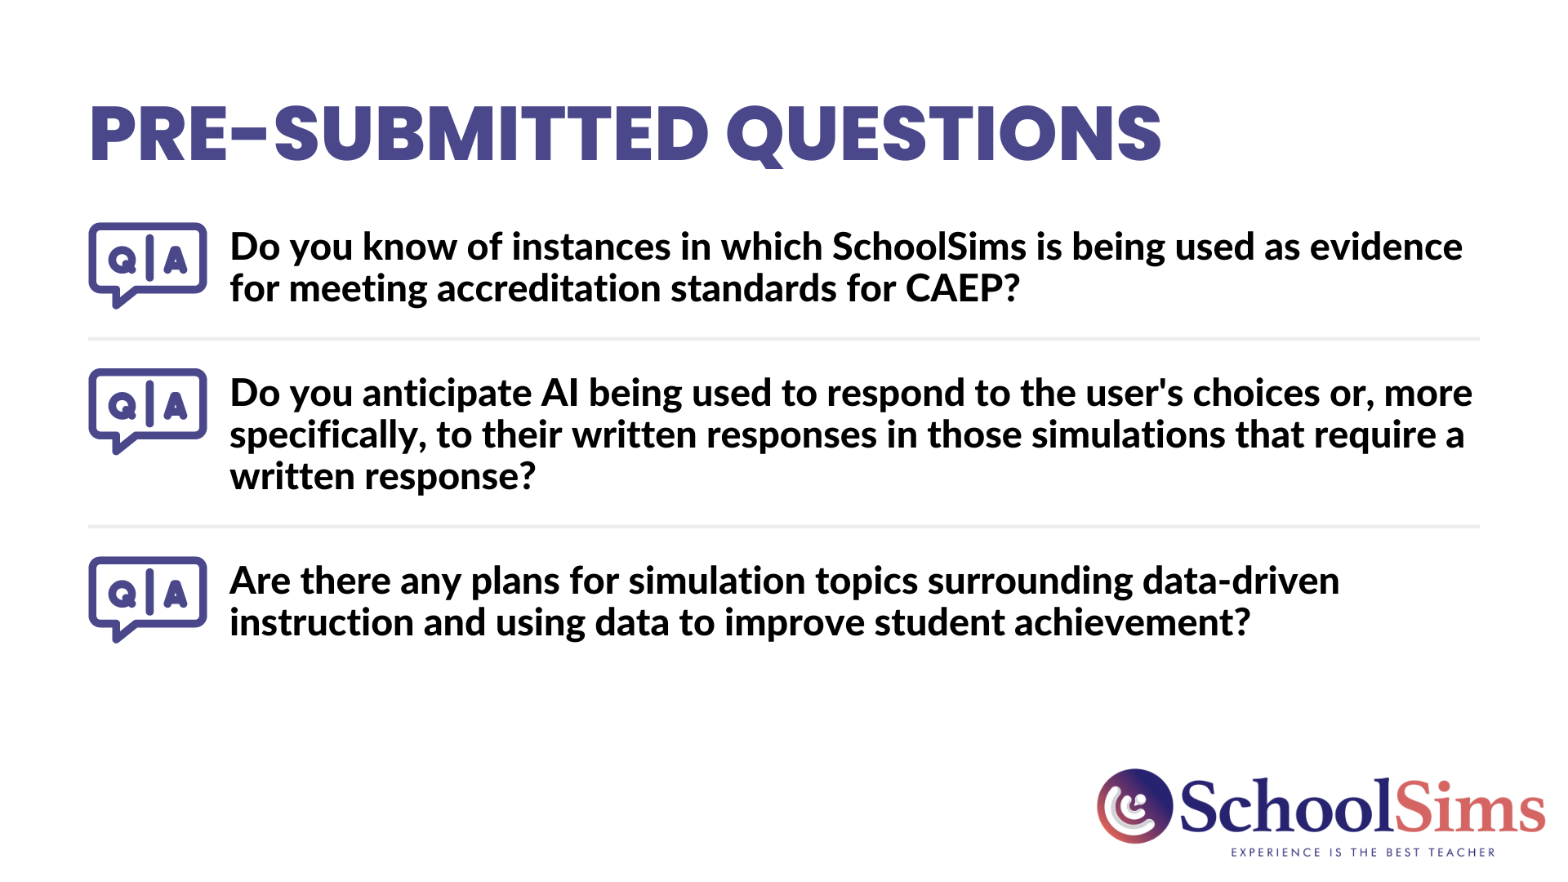

Slide 10
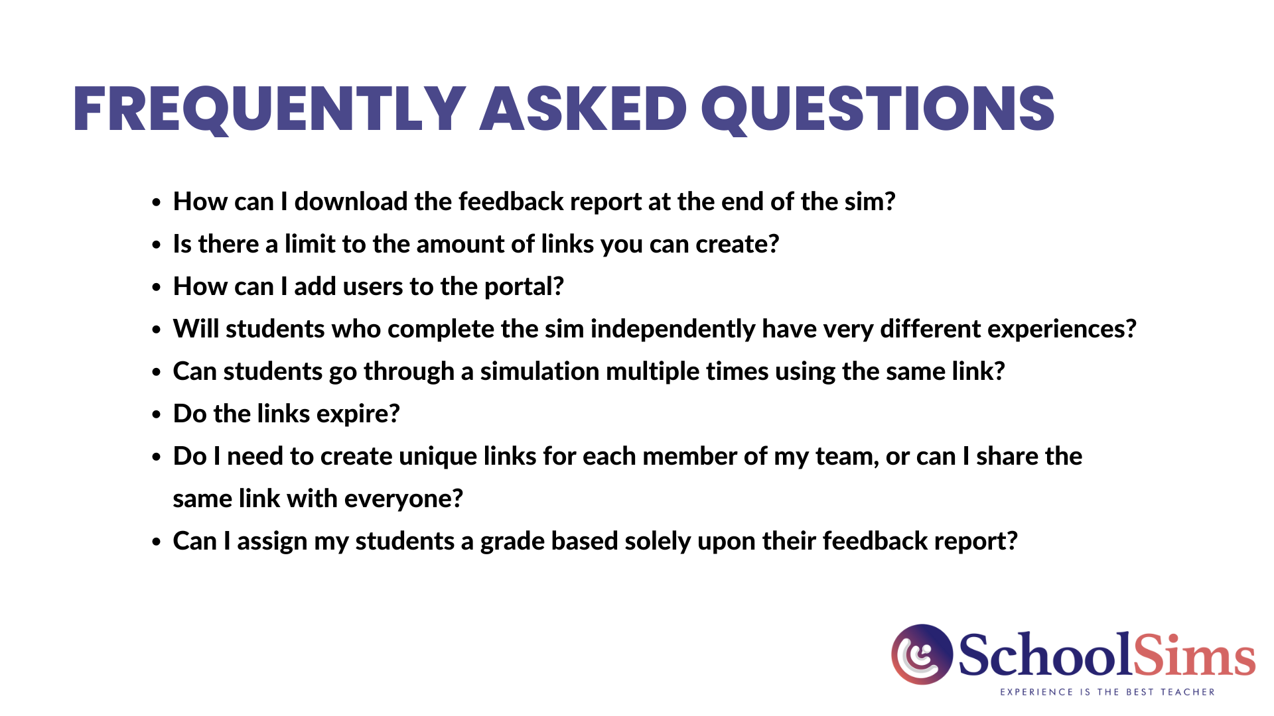
Frequently asked questions
How can I download the feedback report at the end of the sim?
Is there a limit to the amount of links you can create?
How can I add users to the portal?
Will students who complete the sim independently have very different experiences?
Can students go through a simulation multiple times using the same link?
Do the links expire?
Do I need to create unique links for each member of my team or can I share the same link with everyone?
Can I assign my students a grade based solely upon their feedback report?

Slide 11
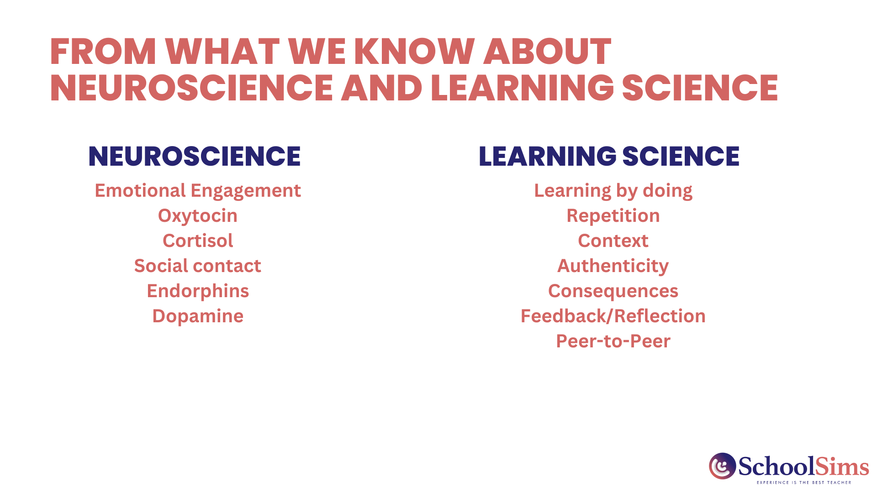


Slide 12


Slide 13
RESOURCES
Simulation Overviews
Explore detailed snapshots of each simulation, featuring key characters, discussion topics, relevant standards, and more!
Preview the SchoolSims Library
Discover a diverse array of simulations tailored to support professional development through engaging and interactive learning experiences across various topics.
Client Testimonials
Read success stories of schools that have implemented simulation-based learning with SchoolSims, highlighting their achievements and positive outcomes.
Blog
The SchoolSims Blog serves as a dynamic platform for insightful articles, updates, and resources on education, simulation-based learning, and innovative teaching methodologies.
Webinars
Access past webinars and discover valuable insights, resources, and expertise on various topics related to education and simulation-based learning.

