Slide 1


Slide 2
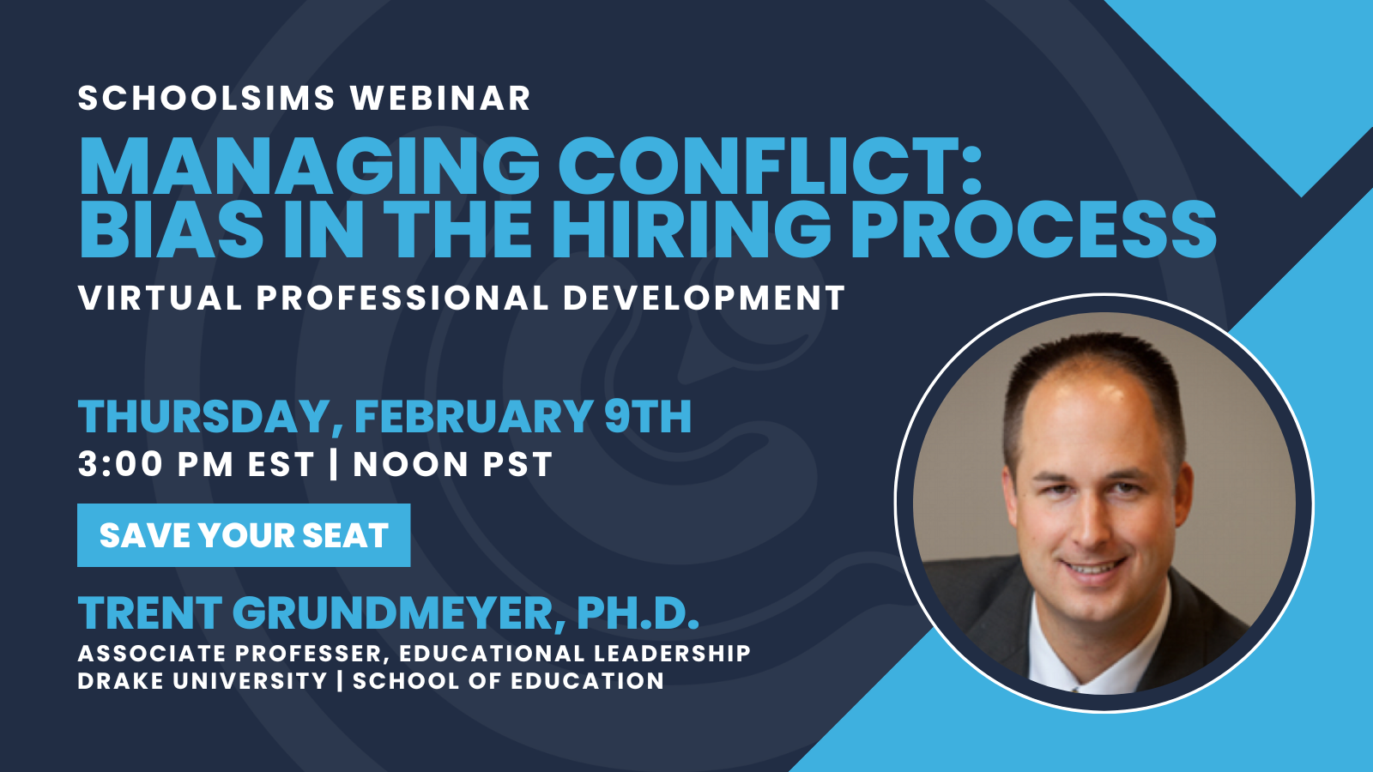

Slide 3
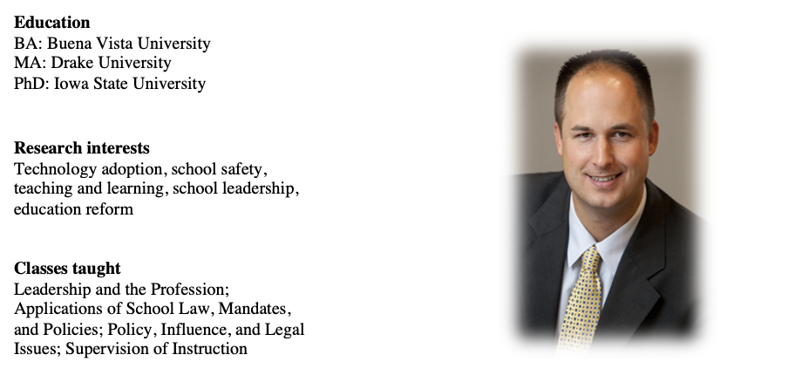
Trent Grundmeyer, Ph.D.

Slide 4
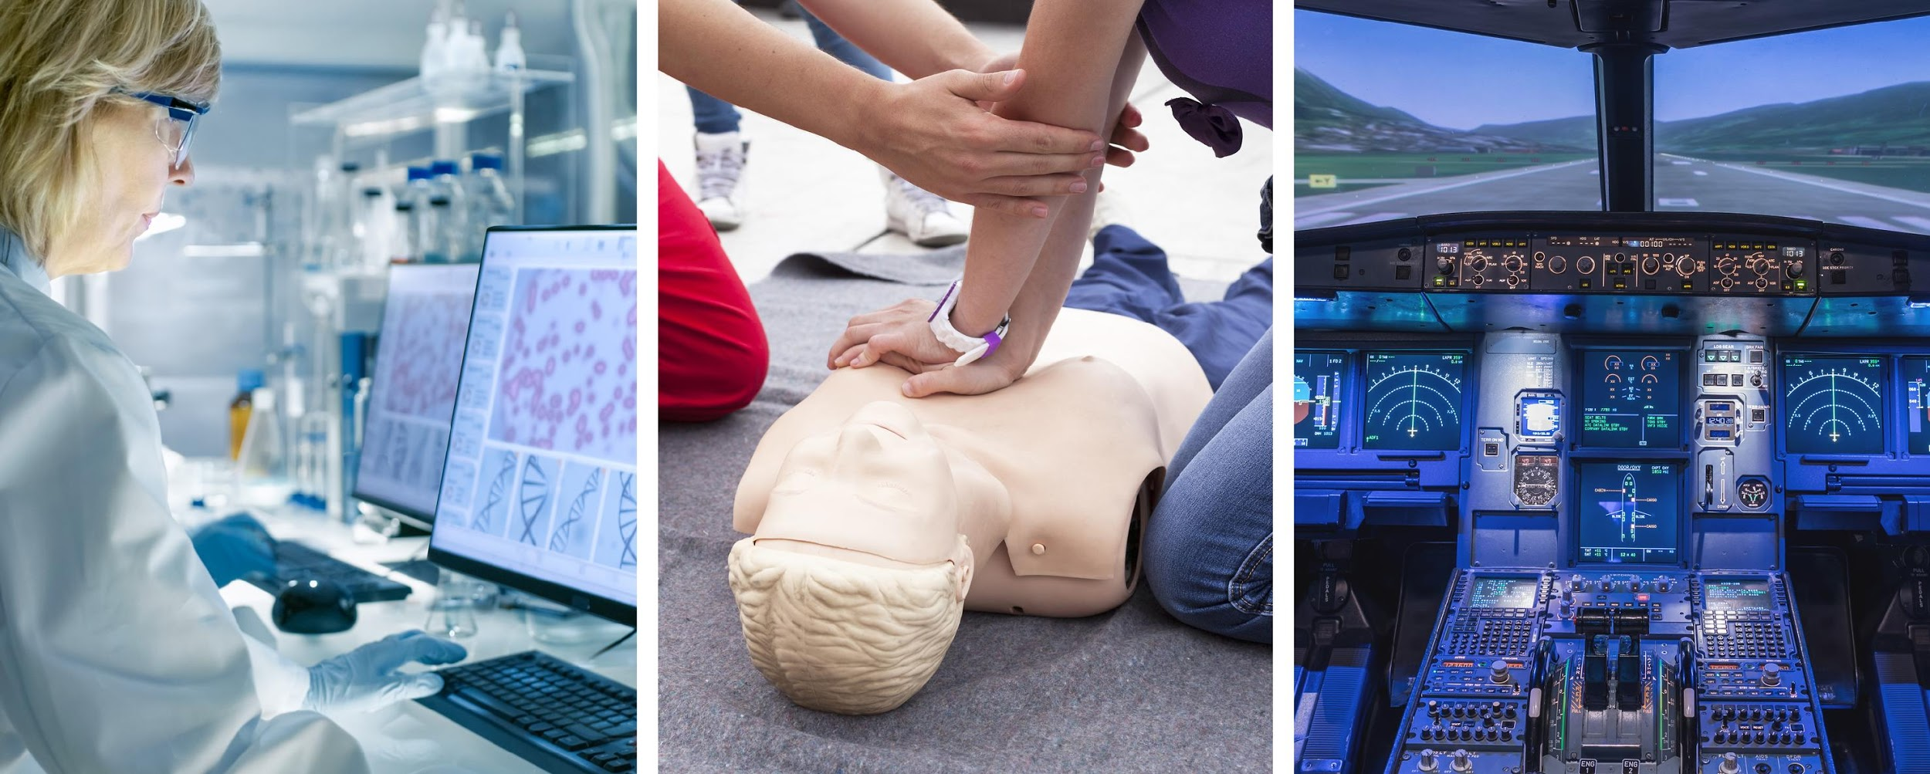
Simulations Already Effective in High Stakes Industries
Notes:
‘Simulating’ processes, policies, dynamic interactions, synthesis of issues in decision making, tradeoffs, behavioral/performance change etc.

Slide 5
The Introduction
SchoolSims are video-based, interactive simulations designed for aspiring, novice, and experienced school leaders and teachers. SchoolSims provides a safe learning environment where participants gain leadership experience without any real world consequences. Experience is the Best Teacher!
Q: What are SchoolSims?

Slide 6
The Solutions
SchoolSims can be used in various ways:
Synchronously
Asynchronously
In-person
Video Conferencing (i.e. Zoom)

Slide 7
Simulation Topics & Titles
LeaderSims
Synergistic Leadership
Uncovering Hidden Inequity
Navigating the Politics of Equity Based Budgeting
Cultural Competency
Middle School Turnaround (Implementing Change)
Value-Based Leadership
Emerging Challenges of Distributed Leadership
Managing Diversity in a Growing Community
Middle School Budget Challenge
Administrator: First Week On The Job
TeacherSims
Building Inclusive Classrooms: Affirming Diverse Families
Building Inclusive Classrooms: Positive Learning Environment
Facilitating Alignment (IEP)
Special Education: Annual Case Review
Disruptive Teacher
New Teacher Evaluation
Academic Goal Setting
Difficult Conversation: Race
CounselorSims
Comprehensive Role of School Counselors
Virtually Leading a School Counseling Program
Data Driven Counseling
School Safety
Planning for Student Achievement (Fall 2022)
Student Support (Transgender)
Student in Crisis
Including many more not listed!
Notes:
Intro Slide
What States we are in
Higher Education
Highlight Ken Spero
2 Slides
Range of the libraries
Ed Leadership Programs
35 Sims
Highlight a few titles
LeaderSims, TeacherSims
1 slide where we are and 1 slide on the simulations

Slide 8
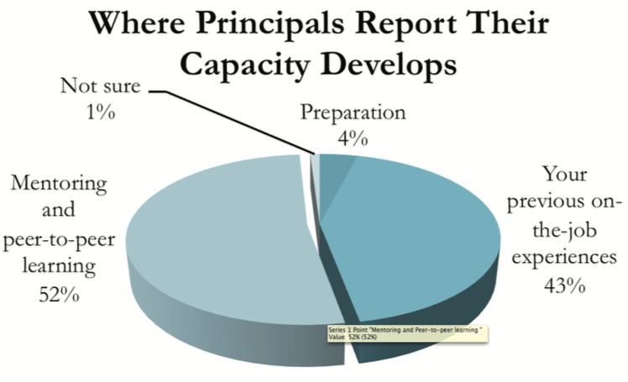
Did You Know?
9 in 10 principals feel they should be responsible for everything that happens to a student
3 out of 4 principals feel the job has become too complex
Average principal tenure is less than four years… and worse in low-income areas
One of the key reasons for churn is a lack of time and money for continued job preparation
Notes:
Experience is the Best Teacher, we know this and as we think about the Importance of “relevant” and helpful experience you can see that from the top lines of both sides of this slide in 9 of 10 Principals feel they should be responsible for everything that happens to all of their student a that over 90% of their capacity building comes from their or someone they are close to’s experience
On top of that, the complexity of what Admins are being asked to deal with or are asking of themselves to deal with is ‘off the charts’ as we have added the implications of the Pandemic into the already complex challenge so the importance of being able to get relevant experience in a scalable way has only gotten more dramatic
The consequence of all of this is that Admins will end up leaving their jobs because it is just too much and they were not adequately prepared for it and the cost of that is very high in terms of both the physical costs but even more importantly to the academic achievement of our students

Slide 9
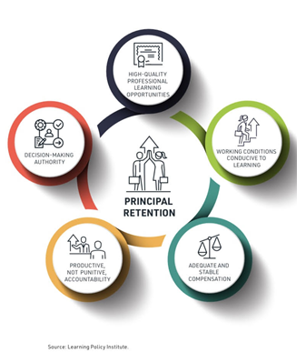
The High Cost of Principal Churn
After teachers, principals have the most impact on student achievement
Increased principal quality leads to gains in high school graduation rates and student achievement while turnover in school leadership can result in a decrease in student achievement
Cost to replace a principal = $75K
“Given the high cost of putting effective principals into the job, and the higher cost to students whose future success depends upon tenacious leadership, we must do more to protect these investments.”
Notes:
The recent Wallace study has shown what we have all known, that Leadership is probably the important factor towards improving student achievement. Even though we know that teachers have the highest impact on individual students, the study showed that Principals also contribute to the individual student but they have the potential to affect both students and also those good teachers so that there is a multiplier effect
As we saw in the Sim, the Leaders helps to establish and maintain a positive climate from which achievement can flourish for all students and teachers. Establishing a vision for continuous improvement is key, but even more important is sustaining the effort so that it has the opportunity to be benefited from and this takes time
Although the immediate cost of churn has been shown to be $75k in hiring and onboarding, the additional costs of time and effort to restart an improvement process and undo/redo what may have been started are very high
On top of that is the initiative fatigue and school climate affects of a perceived ‘revolving door’ at the top
Keeping and improving our leaders and their capacity are key to addressing the needs of our students, especially in these times of great uncertainty where consistency and communication are so key to maintaining connections and enabling successful implementation towards student achievement

Slide 10
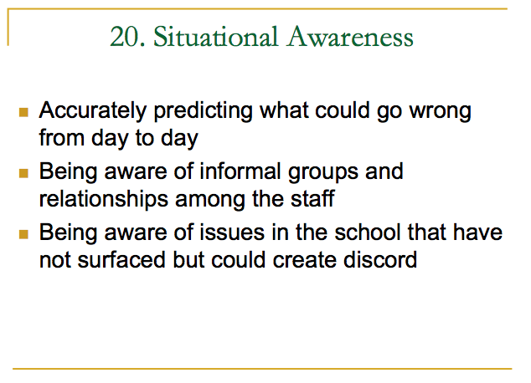


Slide 11
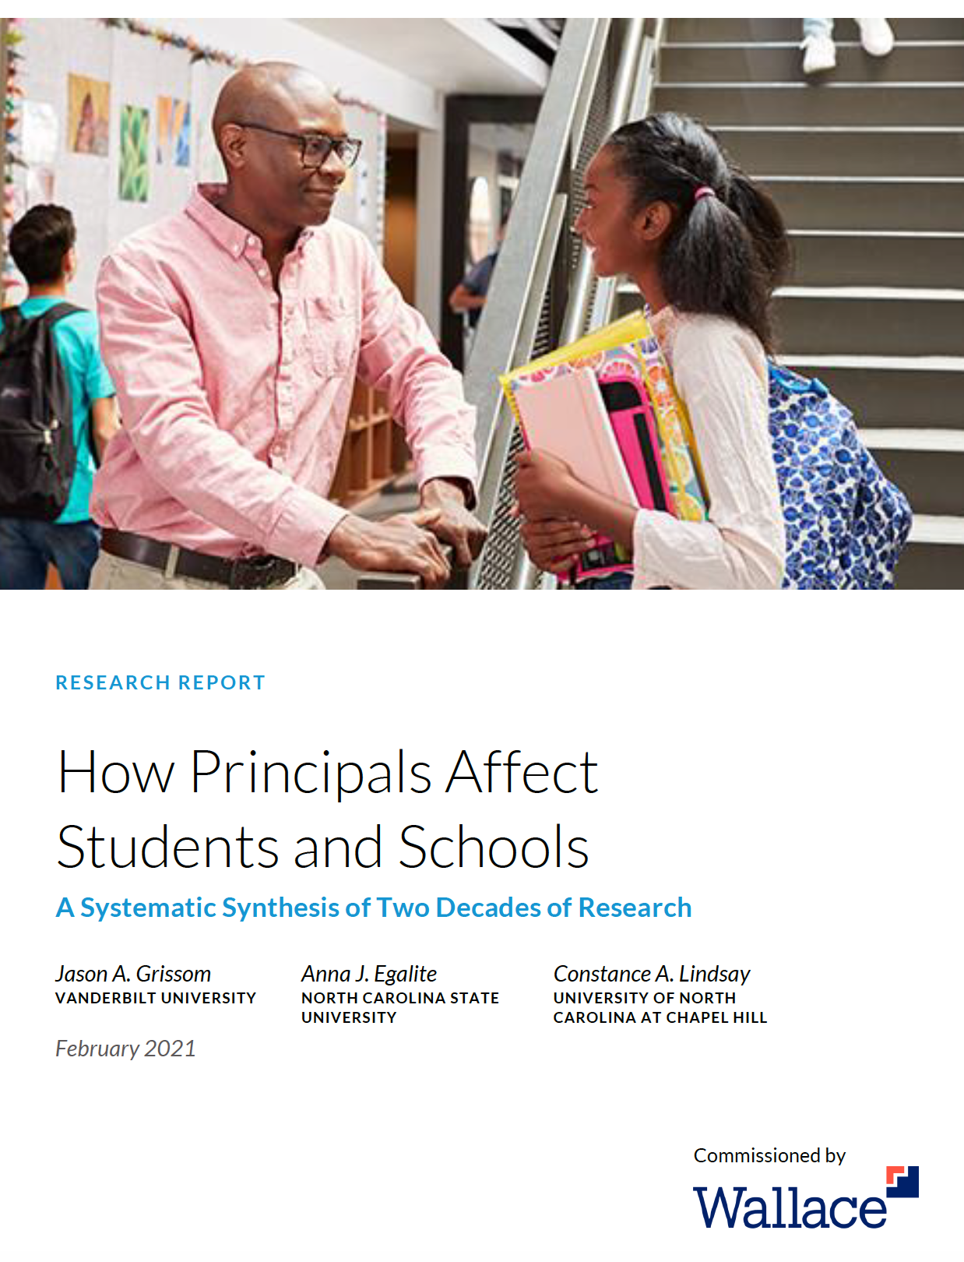
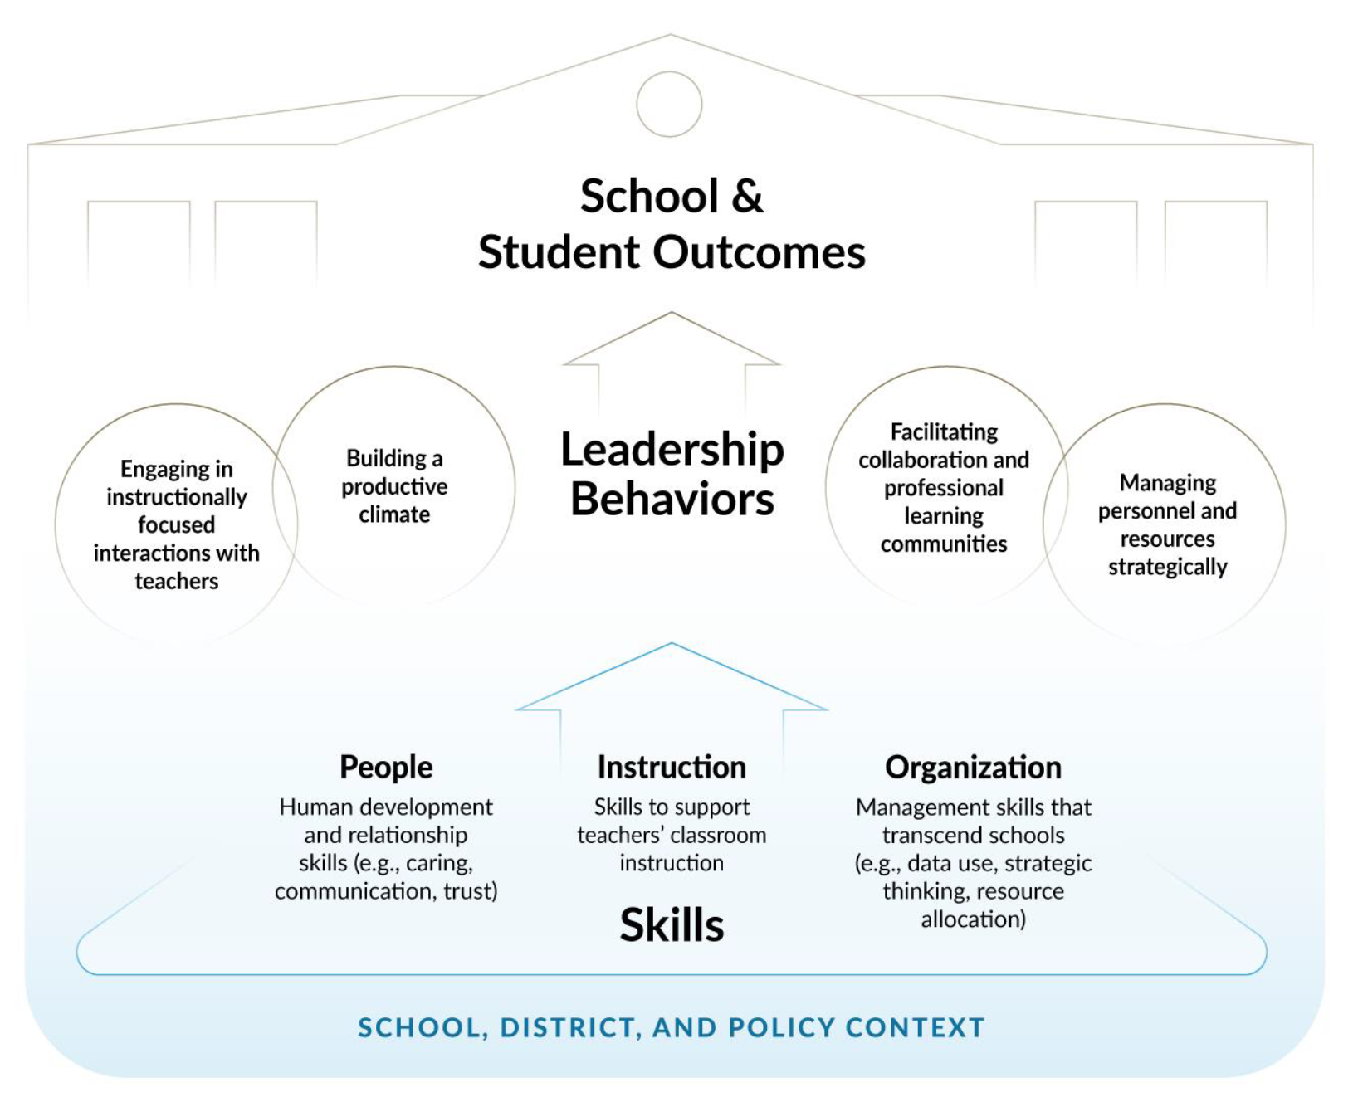
Wallace Research

Slide 12
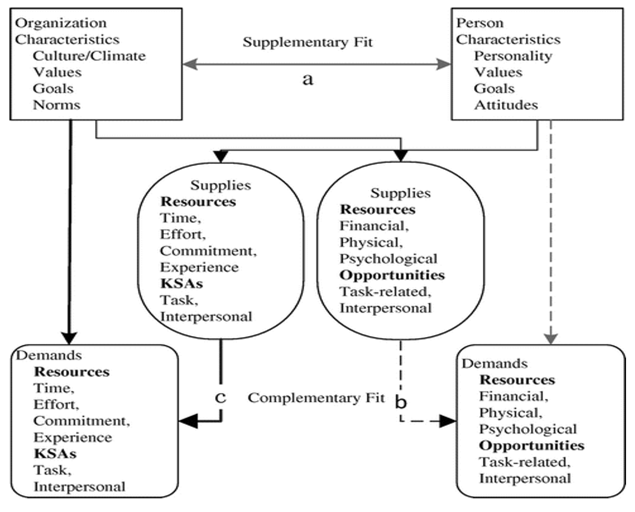
Notes:
Person-Organization Fit Diagram
Kristof, 1996; Pin-Chao, et al. (2015 ).

Slide 13
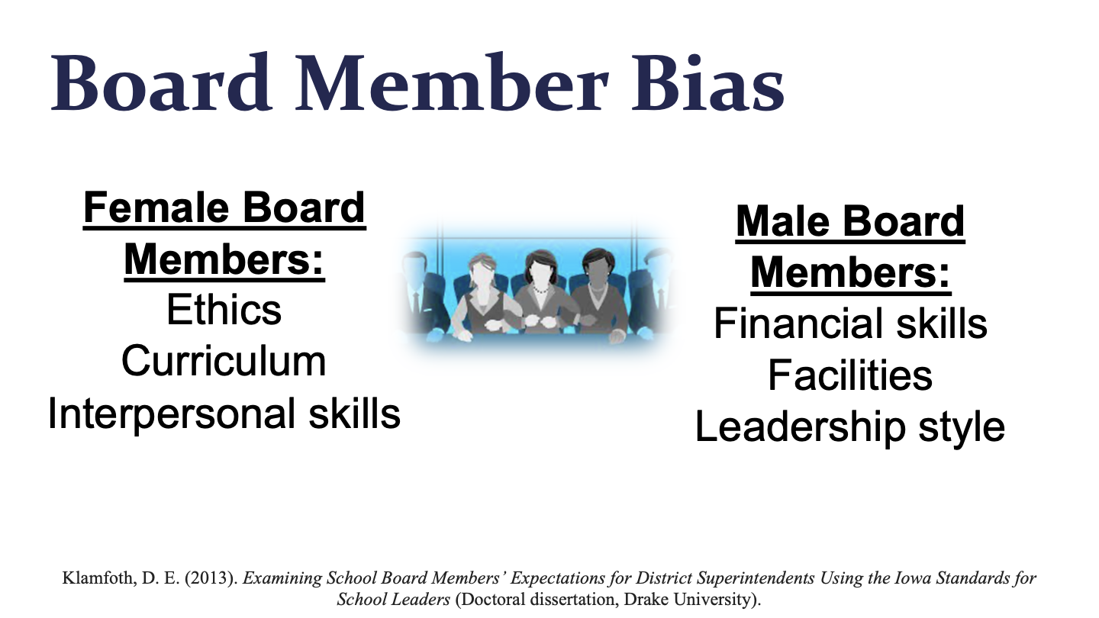

Slide 14
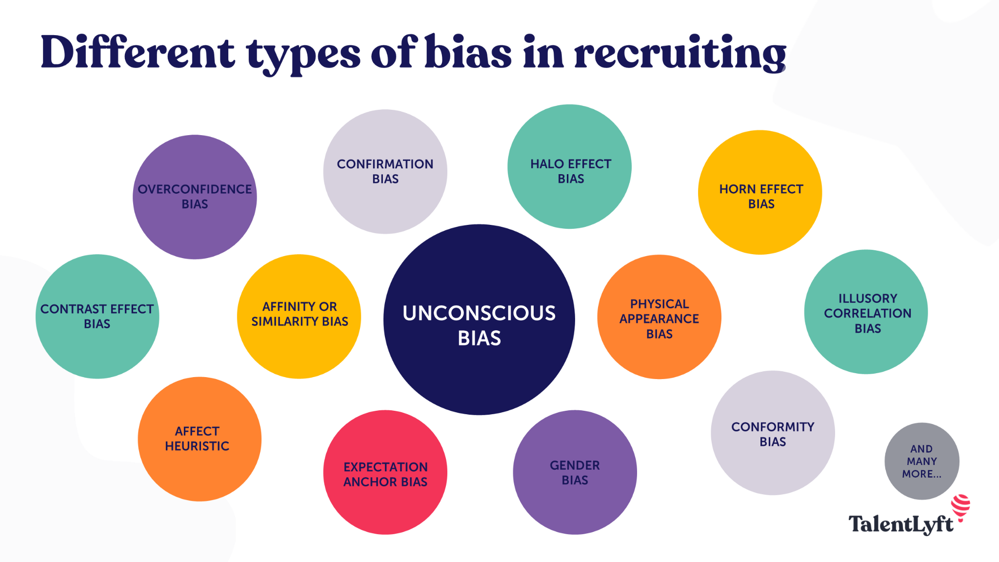
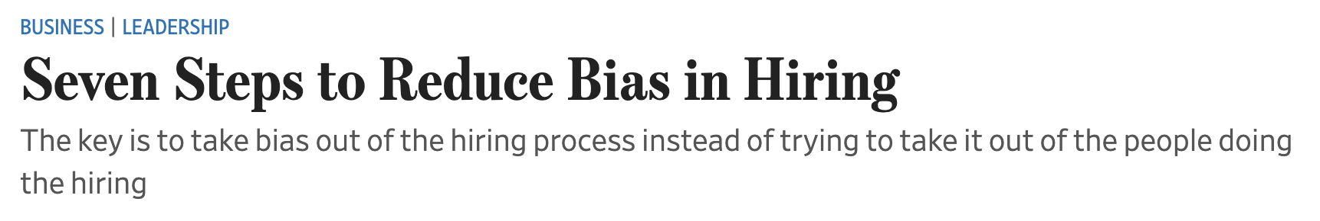

Slide 15
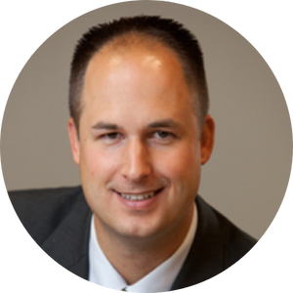

Trent Grundmeyer, Ph.D.
Associate Professor Educational Leadership
Faculty Administrative Fellow for Graduate Programs
School of Education | Drake University
What are some of your findings from your research involving simulations?
David, D., & Grundmeyer, T. (2018). Educational leadership simulations: Learning lessons from behind the curtain of educational leadership. International Council of Educational Leadership Preparation, 13(1).
Discussions were highly engaging and stimulated critical thinking
Simulations helped to realize different perspectives
Increased confidence to lead
Grundmeyer, T. (2019, April). Using simulation to make it stick. A presentation at the Iowa 1:1 Institute. Des Moines, IA.
Simulations promoted long-term retention of important concepts
Grundmeyer, T. & Mathews, M. (2018, May). The Impact of Emerging Technologies in Education. An invited keynote presentation at the Blockchain and Augmented and Virtual Reality in Education Conference. Tulsa, OK.
Simulations are a proven training method that have been around for years and should be leveraged in education
Simulations are on the “horizon” for mainstream adoption in education (2022 Educause Horizon Report)

Slide 16
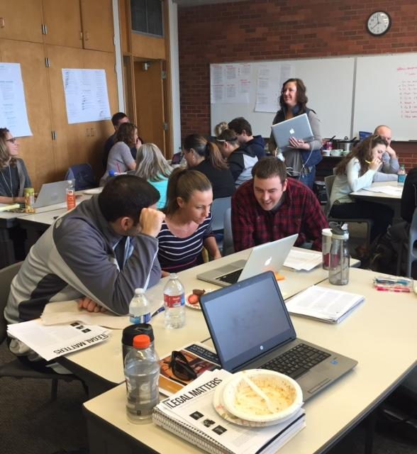
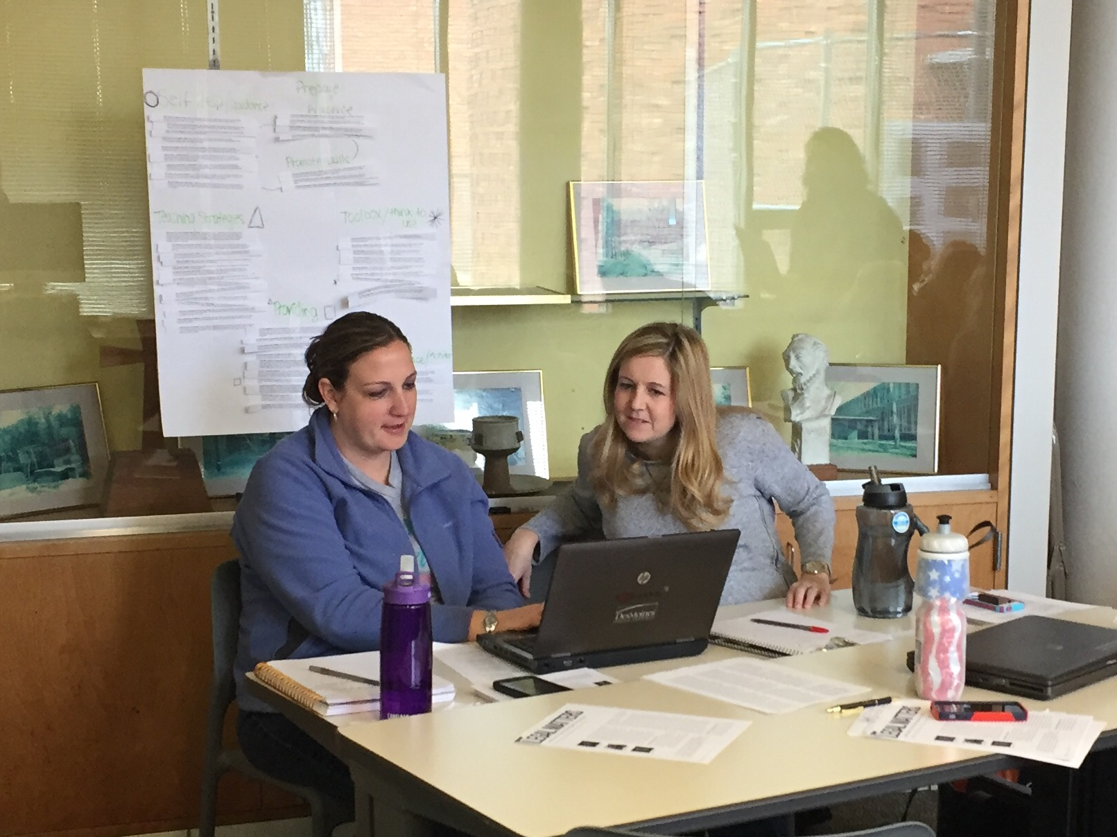
Simulations
David, D., & Grundmeyer, T. (2018). Educational leadership simulations: Learning lessons from behind the curtain of educational leadership. International Council of Educational Leadership Preparation, 13(1).

Slide 17
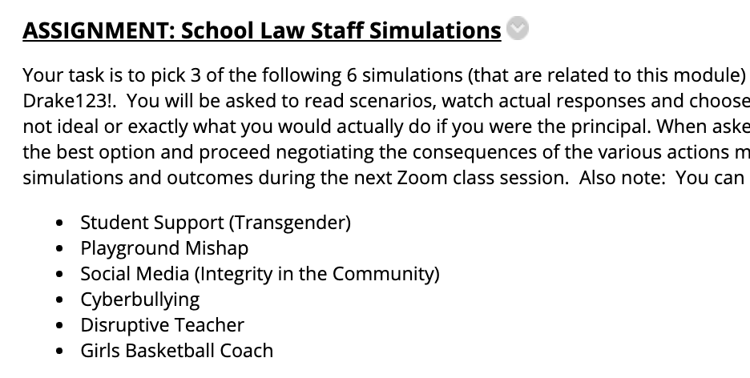
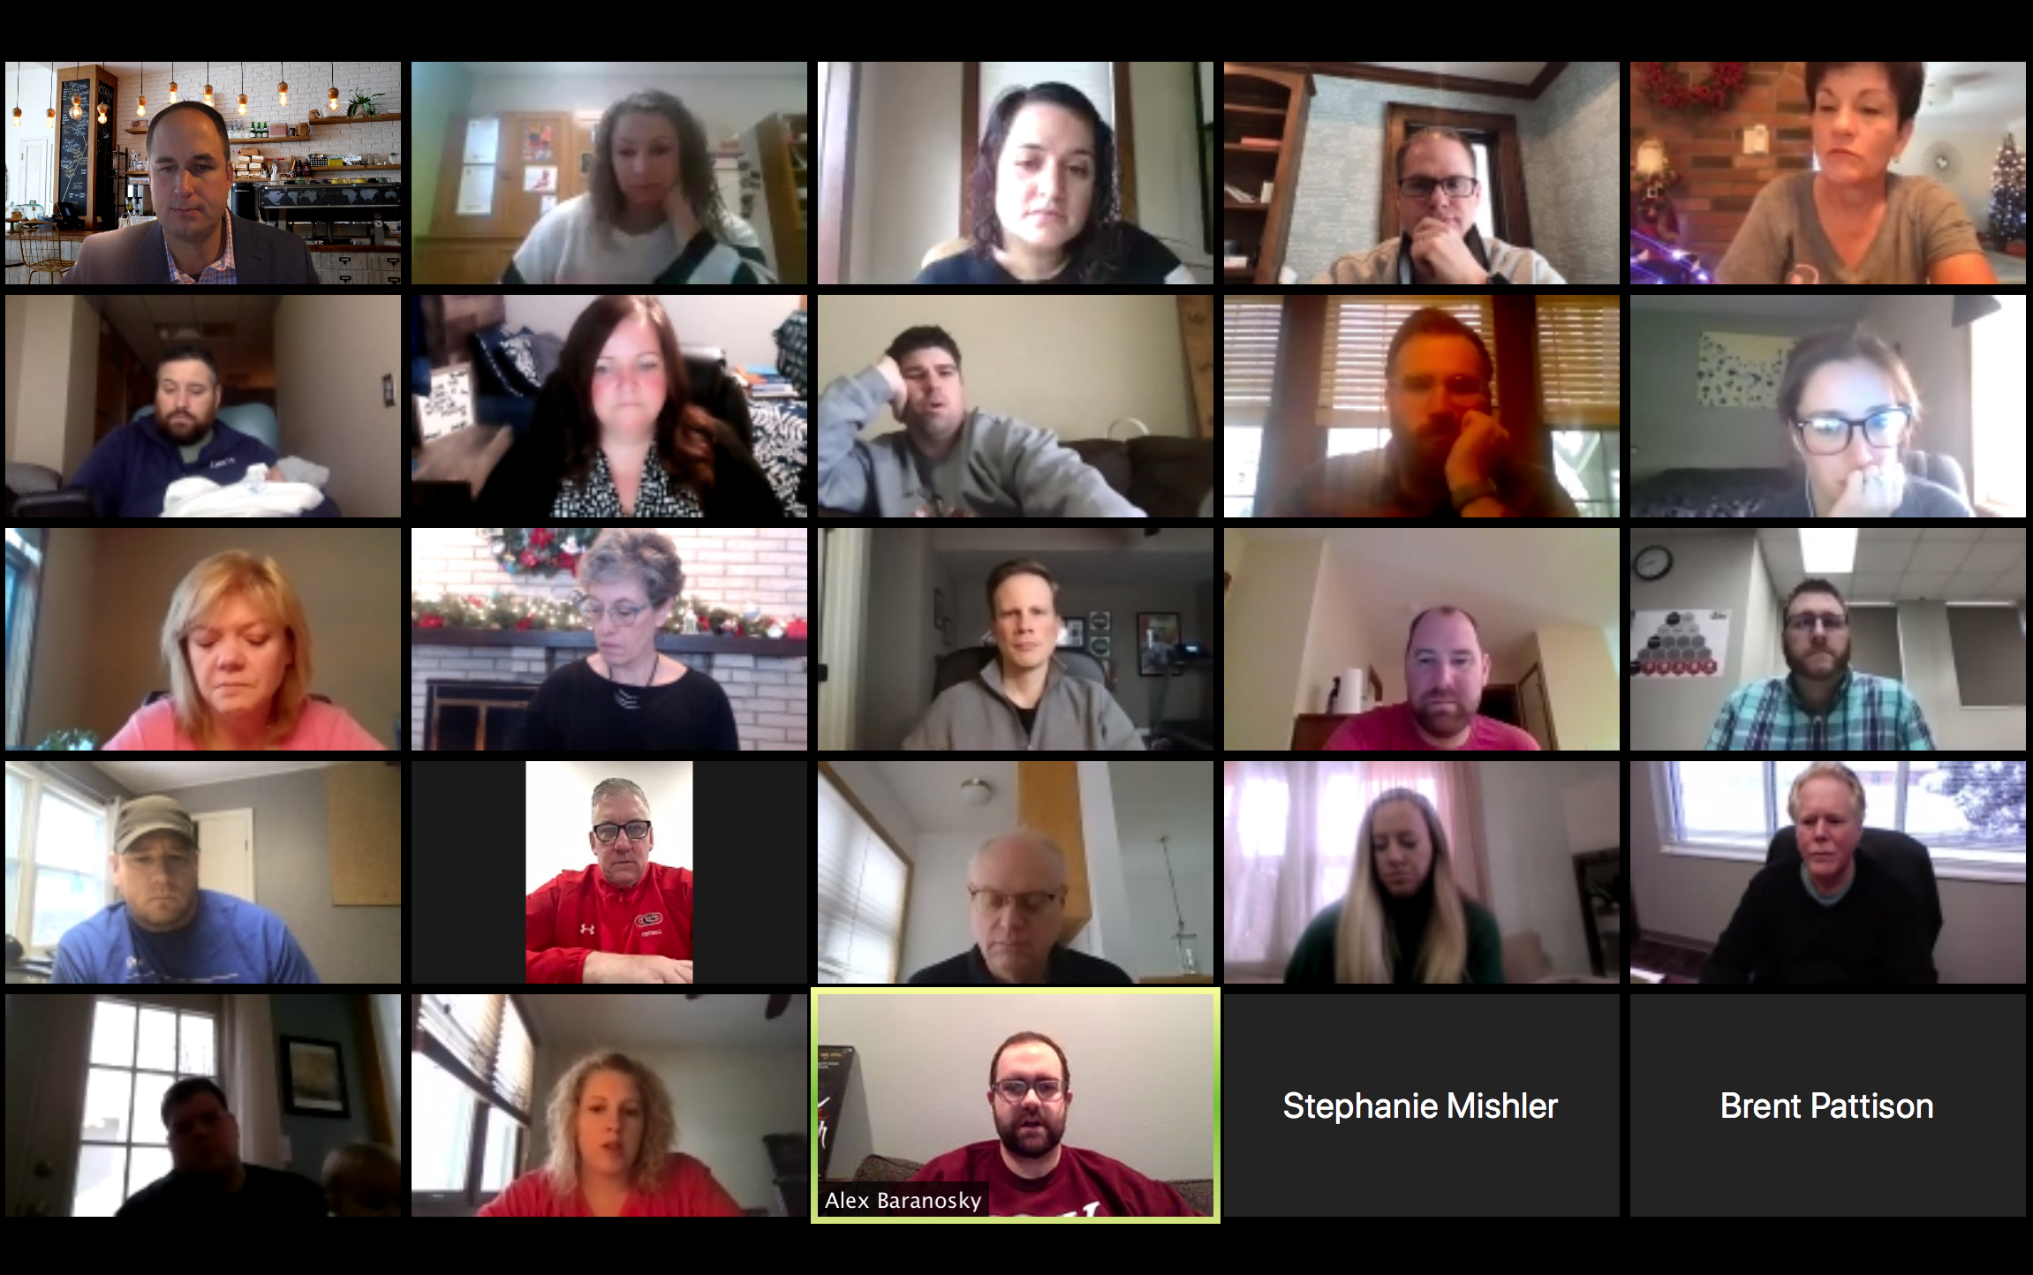
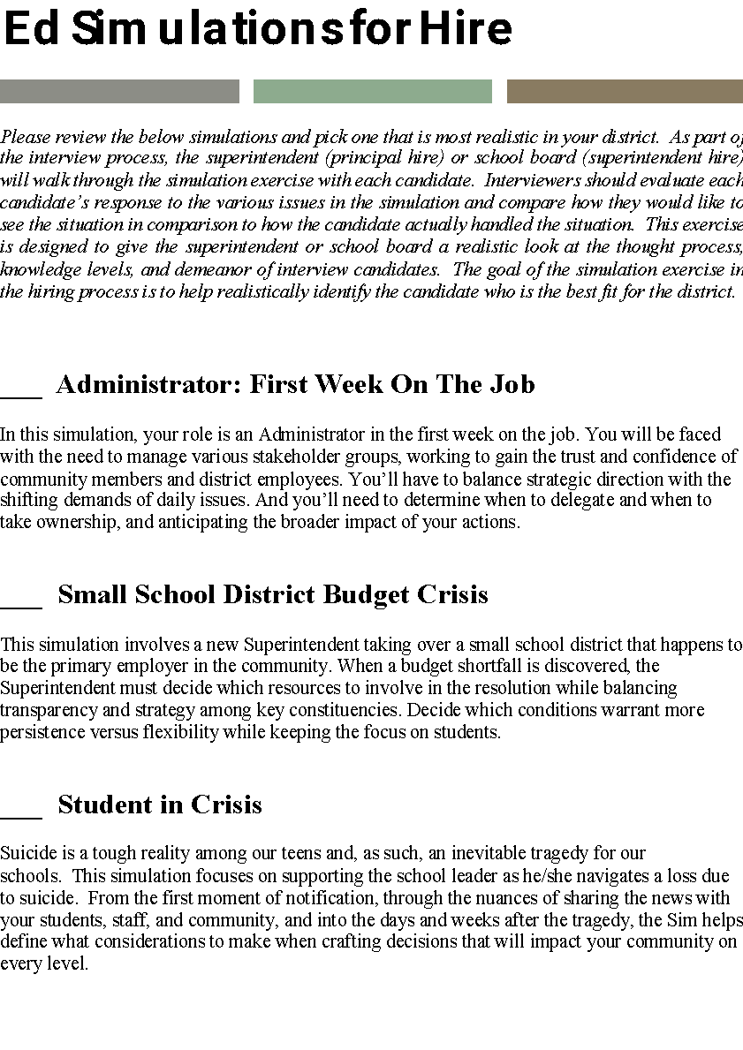

Slide 18
Student Feedback
“These simulations were great experiences that were actually engaging and could definitely happen to any of us individually or as an entire district.”
“The simulations were a great way to get in depth conversations started. It was great to think about what I would do in these specific situations!”
“I liked having the discussions during the simulations. This allowed me to see the perspective of others.”
“The sims gave me confidence in how I would respond to an issue in order to continue/establish strong inter-relationships with staff, parents, and community.”

Slide 19
Please take a moment to respond to the poll and let us know what you thought of the webinar today.

Slide 20

Notes:
Request more information about simulations
Mention the past sim development webinar

Slide 21


