Slide 1


Slide 2
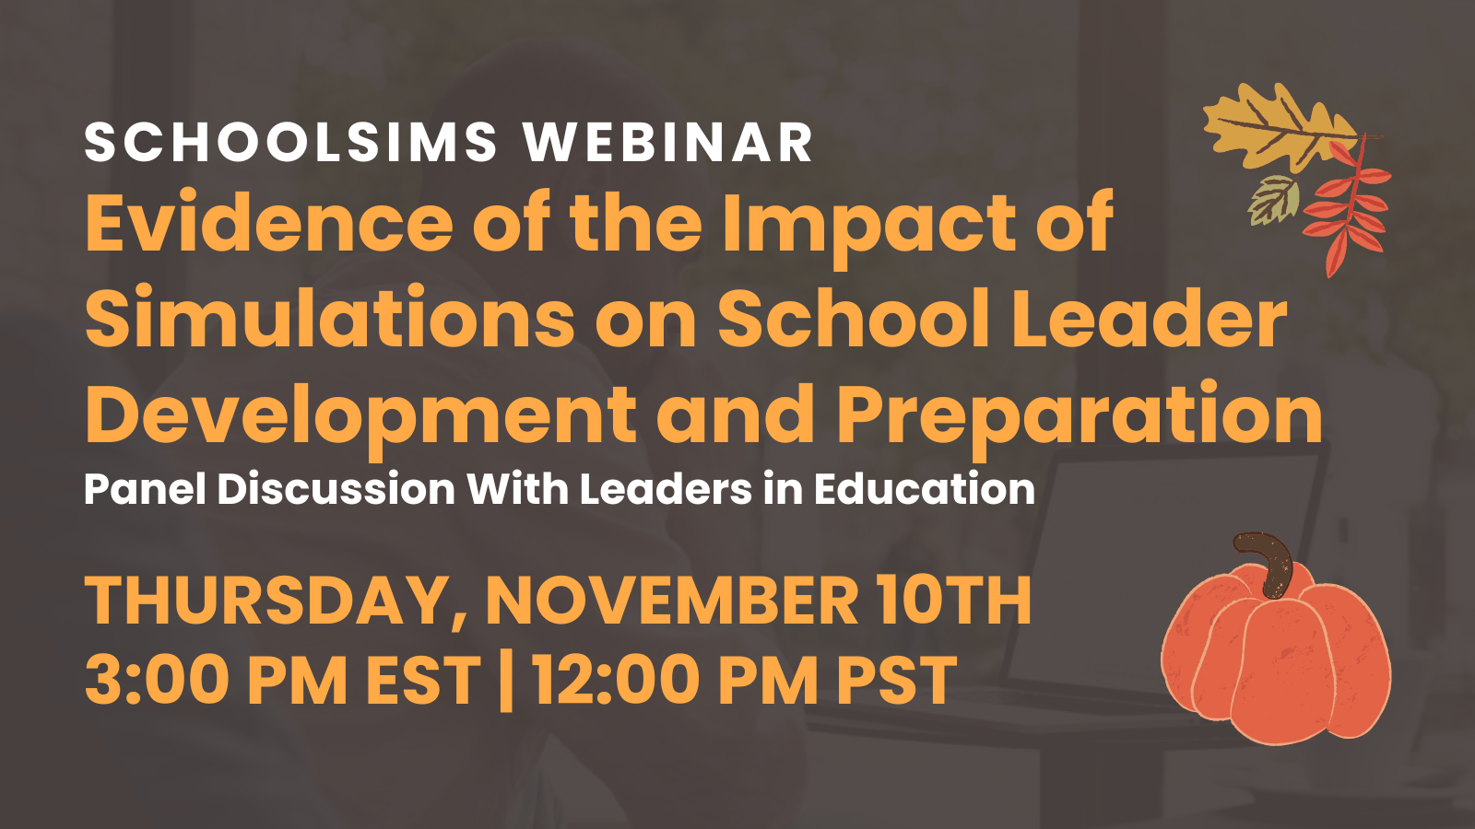

Slide 3
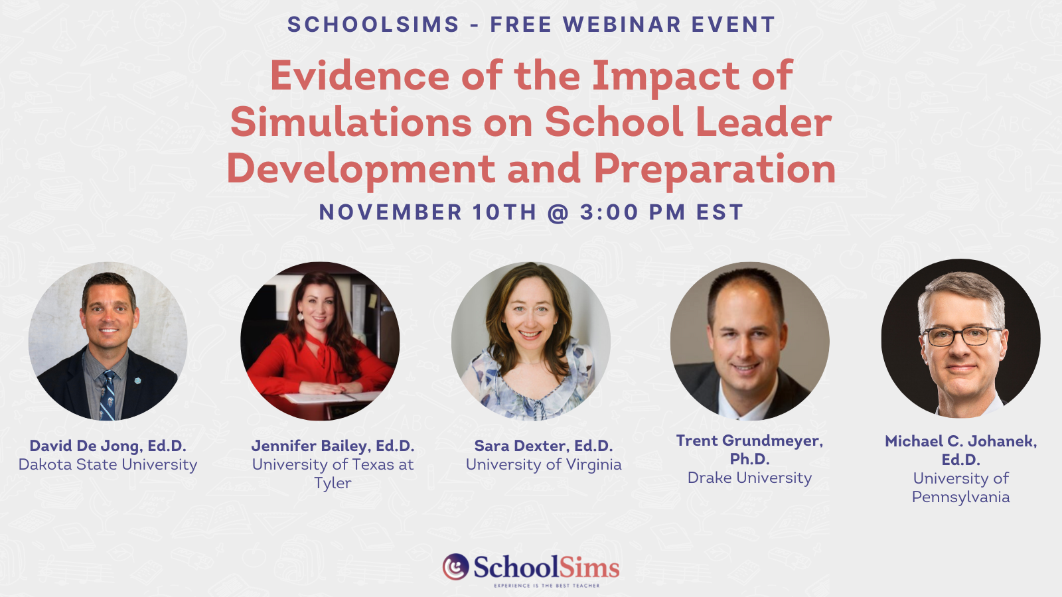

Slide 4


Ken Spero
President & Co-Founder
kspero@schoolsims.com

Slide 5
SchoolSims: Sims Impact Review
Alma Advisory Group carried out interviews with administrators from each user group and administered an on-line survey to 121 SIMs training facilitators and participants. Capturing information from these three constituencies allowed for the inclusion of different yet interrelated perspectives. Five user groups participated in the review. Their length of experience using the SIM was the primary criteria for inclusion in the study. Administrators, training facilitators and participants from three school districts, a state department of education and a state devel principal and supervisor association participated in the study. The study yielded the following select findings:
All groups report that the SIMs provide opportunities for rich discussions and provide a “sandbox” for aspiring leaders to experiment with making decisions in a safe environment.
The theory of action is that taking the SIMs will improve school leaders’ ability to successfully handle similar situations when they emerge, and will also help them make better decisions overall by 1) increasing awareness of the potential (negative) results certain decisions and 2) modelling reflective decision making. Responses from program administrators as well as the facilitators and participants support this theory.
Administrators reported that the SIMs were well-aligned to their standards. Survey responses from facilitators and participants support this finding.
There is consensus across groups that SIMs engage participants in the material and that participants learn as much or more when using the SIMs compared to other professional development, and there is near universal satisfaction with the SIMs.
Lastly, the Sims were mapped to the EDC Quality Measures Rubric and the Project Based Learning Framework

Slide 6


Sara Dexter, Ed.D.
Associate Professor, Administration & Supervision, Department of Leadership, Foundations & Policy
Co-Director, CASTLE of UCEA (Center for the Advanced Study of Technology in Leadership Education, of the University Council of Educational Administration)
What are some of your findings from your research involving simulations?
Pt 3: Dexter, S., Moraguez, D., Clement, D. & Thornton, M. (2022, November). Assessing and Building Pre-service Leadership Decision Making Self Efficacy. Paper to be presented at the annual conference of the University Council for Educational Administration, Seattle, WA
Pt 2: Clement, D., Moraguez, D., Thornton, M., & Dexter, S. (2021, November). Instructional Considerations for Implementing Sims in Educational Leadership Preparation. Paper presented at the annual conference of the University Council for Educational Administration, Columbus, OH.
Pt 1: Dexter, S., Moraquez, D. & Clement, D. (2022), Pedagogical Gaps in the Bridge from Classroom to Field for Pre-Service Principal Competency Development, Journal of Educational Administration, 60 (5), 473-492.
Typology: Dexter, S., Clement, D., Moraguez, D., & Watson, G. S. (2020). (Inter)Active Learning Tools and Pedagogical Strategies in Educational Leadership Preparation. Journal of Research on Leadership Education, 15 (3), 173-191.
Notes:
Typology 2020 (inter)active - The team began with a lit review to discuss Key Cognitive-oriented Characteristics of Context-rich Virtual Experiences, including digital cases (such as ETIPS), simulations (such as School Sims) , and clinical / digital sims (such as Mursion or role-plays). We characterized these modes as differing in their focus for the learners’ cognition, the prerequisite knowledge, and how the learner reckoned with experience and cognition, concluding they all can play a role in developing leaders’ competences. In this piece we coined the term Virtual Practicum
Pt 1 2022 - Next, we conducted a needs analysis in U.S. Ed Leadership programs with over 100 of the 600 programs in the US responding. We posed a continuum of instructional approaches typically carried out in a classroom, such as use of text and discussion, or traditional cases, to the field, where internships occur. We learned that key competencies vary in how much attention they receive, but also that they are typically taught using just these two modes at each end of the continuum. We concluded that there was a ‘missing middle’ where learners might benefit from receiving more frequent opportunities to learn through digital cases and simulations, or digitally enhanced role-plays becasue of the reasons drawn out in the article just mentioned. I’ll note that the emphasis on digital is that in means traces of decisions and data use are captured for reflection and feedback
Pt 2 2021: Working with SchoolSims, in Spring 2020 we provided volunteer ELLP profs w access to sims for use in a semester to gain insight into the faculty support required to use sims. The findings indicated that perceived benefits, especially authenticity, exceeded any limiting and somewhat minor factors that faculty faced, such as technical challenges, costs, or time constraints. The faculty concluded the sims were, in their estimations, a powerful learning experience.
Pt 3: Over the last two years, in six of 10 courses in UVA’s A&S program we use a mixture of digital cases/ ETIPS, digital sims/ SchoolSims, and via Mursion digital clinical sims/ role plays. We’ve asked students to respond with pre-post surveys about their LDMSE and after each completed sim to reflect on their confidence and certainty of their decisions inherent in that learning experience. Comparing students in LTL and Law, we saw stat sig gains in both courses but more gain in Law, where students started lower in LDMSE. In LTL, they felt more certain of the decisions on each sim and more confident about future decisions. We attribute this to more familiarity as current teachers with LTL–BUT there were SS gains in both courses demonstrating the necessity of practice. Also, students reported in open-ended responses how the learning experiences aided their improving at seeking a sufficient amount of data, demonstrating understanding of professional principles, and being aware of how personal dispositions and values affect decision making.
Next up for our research team is useability and feasibility research on a new platform for delivering VP that is under development now with Pragmatic Solutions, Inc. As well as a survey of our grads asking them to estimate their readiness to carry out leadership responsibilities at internship and in their current roles, and if they used VPs to discuss how those helped them to prepare.

Slide 7


Jennifer Bailey, Ed.D.
Assistant Professor of Practice at the University of Texas at Tyler
Teaches Graduate Programs for Principal Preparation and Curriculum and Instruction
Former Campus Principal and Central Office Administrator
What are some of your findings from your research involving simulations?
Bailey, J., Kaiser, F., Thomas, C., Dillingham, S., Norwood, D., Smith, N., & Brown, A. (2022). The Intersection of Preparation and Practice: School Leadership Learning Through Simulation. NASSP Bulletin, 106(3), 209-231.
1. Multiple surveys indicate principals are leaving the field, citing a lack of responsive professional development as a leading reason. Simulation practice may provide meaningful learning opportunities and facilitate impactful professional development for practicing principals.
2. Simulation provides active practice without the accountability of real-time pressures principals face, which could contribute to the development of germane load, or elaborative schemata (Cognitive Load Theory) for aspiring and practicing leaders.
3. There is no manual for the principalship. Attrition data suggests what we are doing is not working. We can reimagine professional development for aspiring and practicing leaders by creating a metacognitive playbook through intentional practice.
Working manuscript that is not submitted: (Bailey, J. Kaiser, F., & Thomas, C.)
“You Don’t Really Get That in the Textbook:” School Leadership Learning Through Simulation, A Mixed-Method Study
-Increased overall efficacy and efficacy in management, instructional leadership, and moral leadership
-Participants reported increased leadership preparedness and positive influence on metacognitive skills in decision-making
Notes:
Bailey, J., Kaiser, F., Thomas, C., Dillingham, S., Norwood, D., Smith, N., & Brown, A. (2022). The Intersection of Preparation and Practice: School Leadership Learning Through Simulation. NASSP Bulletin, 106(3), 209-231.

Slide 8
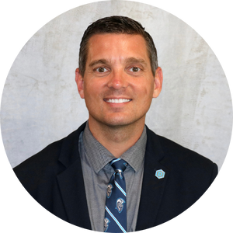

David De Jong, Ed.D.
Dean, College of Education at Dakota State University
Former Associate Professor and Chair of the Division of Educational Leadership in the School of Education at the University of South Dakota
What are some of your findings from your research involving simulations?
De Jong, D., & Grundmeyer, T. (2018). Educational Leadership Simulations: Learning Lessons from Behind the Curtain of Educational Leadership. International Journal of Educational Leadership Preparation, 13(1), 1-12.
Discussions were highly engaging and stimulated critical thinking
Simulations helped to realize different perspectives
Increased confidence to lead
De Jong, D., Curtin, S., Robinson, D., & Cook, J. (2021). A New Way to Facilitate Discourse with School Leaders: Use a Video-Based Simulation. Voices of Reform: Educational Research to Inform and Reform, 4(1): 43–62.
Simulations create a safe space to engage in professional discourse
Working manuscript that is not submitted: “Educational Leadership Simulations in Fully Online Asynchronous Courses: Experiential Learning from the Perspective of School Leaders in Training”
The researchers in this study conducted a content analysis of 826 responses from school leaders in training who experienced a simulation in an asynchronous format and responded to questions on an online, asynchronous discussion board.
Notes:
1. How does this simulation apply to your current or future role?
2. Describe your experience or emotions during the simulation.
3. What are your reflections after experiencing the simulation? What did you learn?
4. What were you thinking about during the simulation?
5. If you experienced a similar situation in the future, what would you do the same or differently?
6. (Only ask if the simulation was experienced in an online, asynchronous setting) Please conclude your response with a question or a statement that explains something you are wondering about.

Slide 9


Mike Johanek, Ed.D.
Senior Fellow in the Policy, Organizations, Leadership, and Systems Division, Graduate School of Education, University of Pennsylvania
Director, Mid-Career Doctoral Program in Educational Leadership
Director, Red Interamericana de Liderazgo Educacional (RILE)
Director, Penn Educational Leadership Simulations Program
Director, The Judgment Project
What are some of your findings from your research involving simulations?
Cites:
Volante, P., Jeldres, R., Spero, K., Llorente, C., & Johanek, M. (2020). Simulations for the learning of decision making in educational leadership in the context of the Chilean school system. Research in Educational Administration & Leadership, 5(1), 1–41. DOI: 10.30828/real/2020.1.1
Bernstein, E., McMenamin, S. A., & Johanek, M. C. (2016). Authentic online branching simulations: Promoting discourse around problems of practice. In P. Dickenson, & J. J. Juarez, (Eds.), Increasing productivity and efficiency in online teaching. IGI Global.
Johanek, M., Volante, P., Mladinic, A., Lincovil, C., & Fernández, M. (2011). Diseño de Assessment Center para la selección de equipos directivos en establecimientos educacionales. Propuestas Para Chile. Pontificia Universidad Católica de Chile.
Current Research: Penn Med/GSE SP pilot; “Pivoting a Profession” Project (Penn Global); Judgment Project (Spencer); measurement (pending)
Lessons/foci:
High engagement (development to experience), research/practice integration
Capture of tacit knowledge within professional infrastructure; practitioner “peer review”
Opens “black box” of practice
Cross-professional lessons
Cross-disciplinary approach
Cross-national conversation
Impact of sim modality
Measuring in situ judgment
From KSD to “KSD + judgment”?

Slide 10
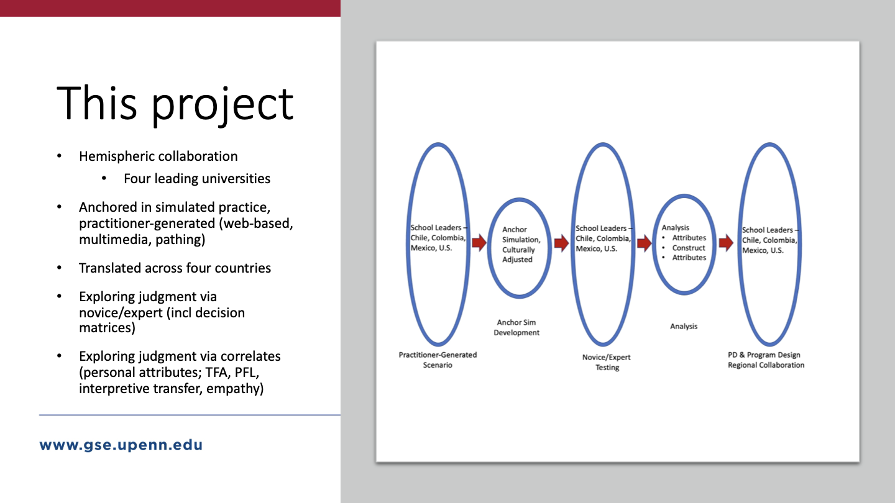

Slide 11
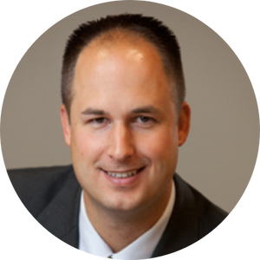

Trent Grundmeyer, Ph.D.
Associate Professor Educational Leadership
Faculty Administrative Fellow for Graduate Programs
School of Education | Drake University
What are some of your findings from your research involving simulations?
David, D., & Grundmeyer, T. (2018). Educational leadership simulations: Learning lessons from behind the curtain of educational leadership. International Council of Educational Leadership Preparation, 13(1).
Discussions were highly engaging and stimulated critical thinking
Simulations helped to realize different perspectives
Increased confidence to lead
Grundmeyer, T. (2019, April). Using simulation to make it stick. A presentation at the Iowa 1:1 Institute. Des Moines, IA.
Simulations promoted long-term retention of important concepts
Grundmeyer, T. & Mathews, M. (2018, May). The Impact of Emerging Technologies in Education. An invited keynote presentation at the Blockchain and Augmented and Virtual Reality in Education Conference. Tulsa, OK.
Simulations are a proven training method that have been around for years and should be leveraged in education
Simulations are on the “horizon” for mainstream adoption in education (2022 Educause Horizon Report)

Slide 12
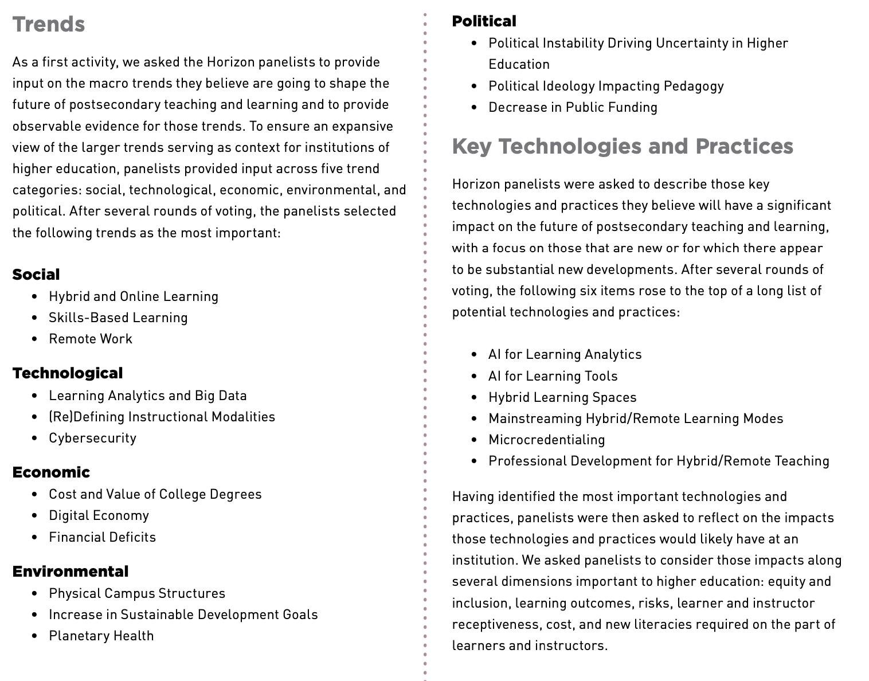
2022 EDUCAUSE Horizon Report
Notes:
Reference if needed.

Slide 13
Ken Spero
President & Co-Founder
kspero@schoolsims.com

Slide 14
Panelist Contact Information:
Dr. Sara Dexter | Email: sdexter@virginia.edu
Dr. Jennifer Bailey | Email: jenniferbailey@uttyler.edu
Dr. David De Jong | Email: David.DeJong@dsu.edu
Dr. Mike Johanek | Email: johanek@upenn.edu
Dr. Trent Grundmeyer | Email: trent.grundmeyer@drake.edu

Slide 15


Slide 16





SchoolSimsPD
SchoolSims

