Slide 1


Using School Sims to Research Gender Bias,
Student Engagement, Online Learning, and More
School Sims is the best tool for aspiring, novice, and experienced school leaders. Experience is the best teacher!
*Please use the chat feature to introduce yourself (name, title, location, etc.).

Slide 2
Dr. David De Jong
About Dr. De Jong
Experience as a teacher, coach, principal, superintendent, professor, and higher education administration.
Awarded the University of South Dakota School of Education Teacher of the Year.
Awarded the University of South Dakota School of Education Researcher of the Year.
30 peer-reviewed publications with a research agenda that includes simulations, school leadership, and mentoring.
President of the Executive Board of the International Council of Professors in Educational Leadership (ICPEL).
Facilitated hundreds of simulations to thousands of school leaders in cities including Toronto, New York City, Washington DC, Charlotte, San Juan, San Antonio, Houston, Dallas, Phoenix, Tucson, Sedona, San Francisco, San Diego, Oakland, and Denver.
Dr. David De Jong
Chair of the Division of Educational Leadership
David.DeJong@usd.edu
(641) 629-0200

Slide 3


Agenda
What questions do you have before we begin? Please feel free to ask any question at any time.
Cliff Notes
Breakout Rooms After Each Study
  Educational Leadership Simulations: Learning Lessons from behind the Curtain of Educational Leadership (2018)
  A New Way to Facilitate Professional Discourse with School Leaders: Use a Video-Based Simulation
  (in press)
  Educational Leadership Simulations in Fully Online Asynchronous Courses: Experiential Learning from the Perspective of School Leaders in Training (in progress)
Question and Answer Time

Slide 4
Cliff Notes
  60% teaching, 30% research, 10% service
  School Sims are highly relevant and engaging (42 out of 42)
  Simulations create a safe place for current and aspiring school leaders to engage in important topics
  Do simulations work in a fully online, asynchronous course?
  Let’s partner on research!

Slide 5
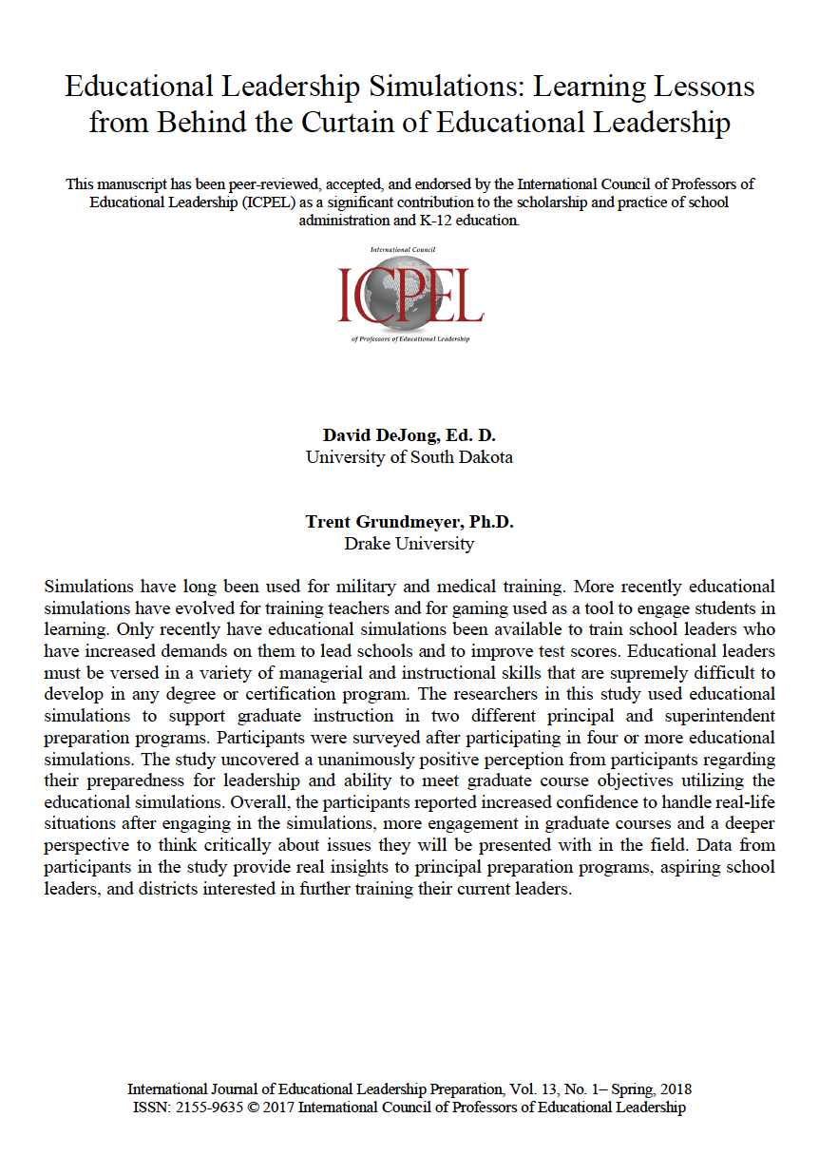
Educational Leadership Simulations: Learning Lessons from Behind the Curtain of Educational Leadership (2018)
  https://scholar.google.com/scholar?hl=en&as_sdt=0%2C16&q=Educational+Leadership+Simulations%3A+Learning+Lessons+from+Behind+the+Curtain+of+Educational+Leadership&btnG=
  42 graduate students from Drake University and the University of South Dakota
  4 themes
    The first theme was that the discussions were highly engaging.
    The second theme was that the discussion stimulated critical thinking.
    The third theme was that the simulations helped participants to realize different perspectives.
    The fourth and final theme was that participants reported an increased confidence to lead through complex scenarios.

Slide 6
Time to Debrief = Three Minutes of Breakout Rooms!
  What stood out to you?
  How could this study be extended?
  What questions do you have for the large group?
  How are you using simulations?
  Could you research how you are using simulations?

Slide 7
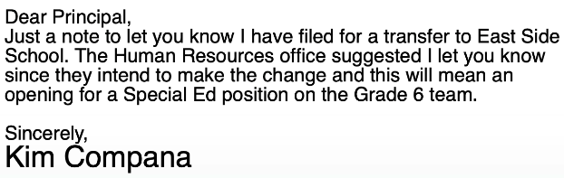
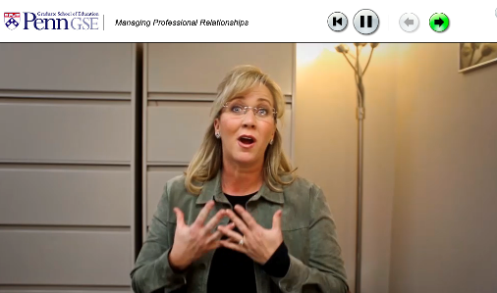

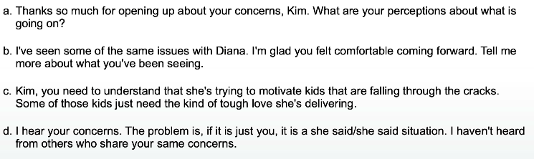
Disruptive Teacher

Slide 8

A New Way to Facilitate Professional Discourse with School Leaders: Use a Video-Based Simulation
(in press)
  https://www.voicesofreform.com/
  https://youtu.be/DPUX3trBYgA
  77 participants
  The influence of the gender of the teacher in the simulation was relevant.
    Female Teacher in the Simulation
      Females are emotional
      The principal should intervene
    Male Teacher in the Simulation
      Males should just handle the situation
      The principal takes the male’s concerns more seriously
  The individual teacher in the simulation mattered more than the gender.
    Leaders would treat the male teacher and the female teacher the same
      Leadership style
      Personal relationship between the principal and the teacher

Slide 9
Direct Quotes After the Simulation
  “We talked a little bit about gender stereotypes of emotional woman, and she’s just blowing things out of proportion.”
  Another participant added, “Girls are just so full of drama.”
  “Does the woman seem like a whiner? Oh, she’s a woman. She must be.”
  “If a female comes in, I'm again probably going to be more like, ‘I'll help you with this. I'll take care of that.’”
  One member of the group discussion came to the conclusion that "...you are going to help her."
  “Stereotypically you would expect a man to be able to handle this situation.”
  Another participant shared, “The professional side of me says, ‘Nope, I’ll sit there, and I’ll treat everybody equal’...but it’s like, ‘Come on, you’re a dude. Go handle this.’”

Slide 10
More Direct Quotes After the Simulation
  "Our group decided to send him back to work and go work it out. I don't know if we would have done this if it were a woman."
  “This is more urgent if coming from a guy, I think…this must be a huge problem.”
  “So, there’s no one that would take the man’s concerns more seriously than the woman’s emotional concerns? {Participants begin laughing in the background}”. This conversation continued with the participant reiterating the question: “I cannot believe there’s not a person in the room that would take a man’s concerns more seriously.”
  “It {the leader’s response} wouldn’t be based on gender but based on the personal relationship I have with them.”
  “A problem is a problem. I don’t think I’d treat them any differently.”

Slide 11
Time to Debrief = Three Minutes of Breakout Rooms!
  What stood out to you?
  How could this study be extended?
  What questions do you have for the large group?
  How are you using simulations?
  Could you research how you are using simulations?

Slide 12
Educational Leadership Simulations in Fully Online Asynchronous Courses: Experiential Learning from the Perspective of School Leaders in Training (in progress)
  Content analysis of 658 responses from school leaders in training who experienced a simulation in an asynchronous format and responded to questions on an online, asynchronous discussion board
  Experiential Learning Theory
  Preliminary Themes
    Simulations evoked emotions from school leaders.
    School leaders wrote about their desire to take action in real life.
    School leaders made connections to their past experiences.
    School leaders knew unethical behaviors when they saw and heard them in a simulation.
    Simulations seem relevant and realistic to school leaders, whether or not they have experienced a similar scenario.

Slide 13
Time to Debrief = Three Minutes of Breakout Rooms!
  What stood out to you?
  How could this study be extended?
  What questions do you have for the large group?
  How are you using simulations?
  Could you research how you are using simulations?

Slide 14

Let’s Partner!
David De Jong
Cell Phone: (641) 629-0200
Email: David.DeJong@usd.edu

Slide 15


Slide 16

Question and Answer Time
Thank you for coming!
I will stay on as long as you’d like.

